Slide 1


Slide 3
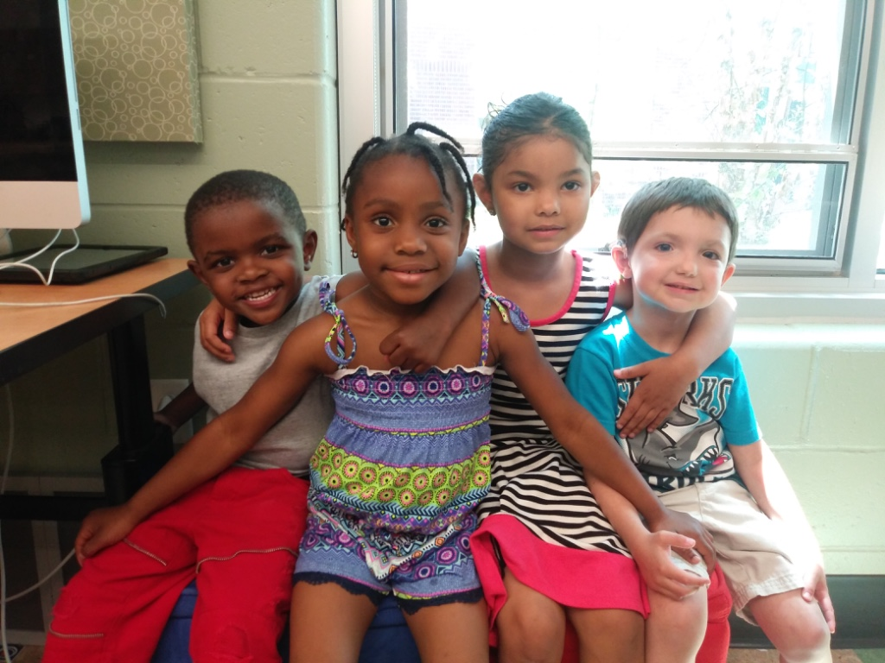
A community.... a place to belong and to learn through full communication access,
whatever that may be for a child

Slide 4
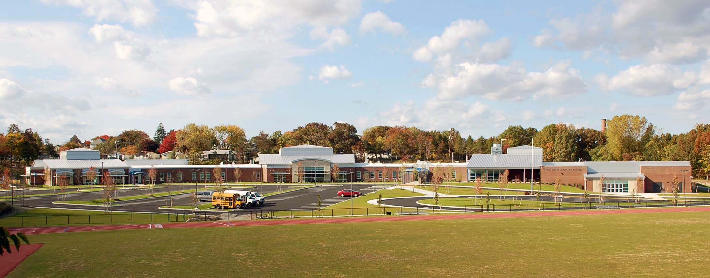
Who Are We?
Bilingual-bimodal, dual language school for deaf and hard-of-hearing students and those with severe communication challenges, who can benefit from instruction in ASL, ages 3- 22 years.
Strategic center, serving as a statewide resource on deafness and hearing loss to charters, school districts, and EI agencies
Outreach and on-site Audiology Center that provides screening, evaluations, and consultation for children and their families throughout RI, ages 6 months to 18 years.

Slide 5
MISSION
Our mission is to
ensure that all Rhode Island children who are deaf or hard of hearing
become literate, independent, and
productive citizens, who set and achieve their own life goals.

Slide 6
School Structure
Structured as a small, diploma-granting, school district… RISD is home to
an early intervention program
an early childhood program (preschool and K),
      an elementary school,
      a middle school,
      a high school,
      18-22 transition programs
      a professional audiology clinic
      afterschool sports and enrichment activities

Slide 7
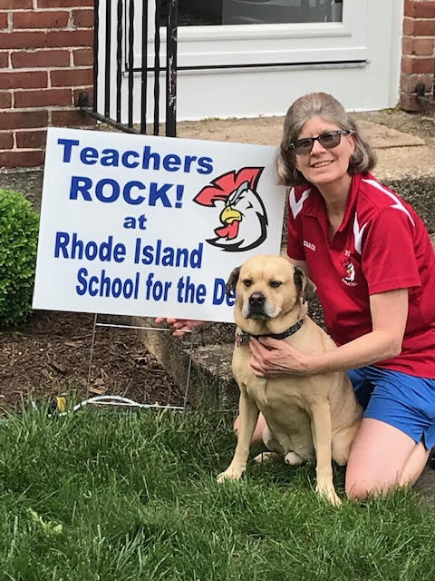
Credentialed Staff
Audiologists (3) • Transition Coordinator (1)
Nursing (1) • Teacher Assistants (5)
Counseling (1) • OT/PT (2)
School Psychologist (1) • Teachers (21)
Speech Language Pathologists (3)
Librarian (1)
Behavioral Support (1)
Home to School Liaison Social Worker (1)
ASL Specialists (2)
ASL Interpreter (1)

Slide 8
SNAPSHOP DATA
Founded in 1876 on Hope Street by Governor Lippett and his wife, who had a Deaf daughter, Jeannie.
Currently in a state-of-the-art school building, off of Hawkins Street, first occupied in late 2010.
Languages of instruction – American Sign Language, spoken English, and written English
All students (100%) are on IEPs
Governed by an appointed Board of Trustees

Slide 9
Census
Serving 82-86 students
(ages 3-22 years)
on-site from 27 RI communities and 2 neighboring states
(out-of state students pay FULL tuition)
Audiology Clinic serves approximately 50,000 children annually
Serving 30+ students through Compass Outreach throughout Rhode Island
Serving 12-16 Rhode Island families (0-3) in an EI sponsored program

Slide 10
RISD: An accessible community
Highly dedicated, professional faculty and staff
Educational philosophy grounded in the belief that all students have a right to full access to the general curriculum.
Focus on the whole child, not only hearing loss
• A language philosophy that is committed to developing visual and auditory
strengths for learning
Ensuring that students retain this right to full and direct access to instruction requires commitment, innovation, and a strong belief that true success comes to the student who has learned first to think.

Slide 11
What does this mean for a child who does not learn easily through audition?
How does a deaf or hard of hearing child learn best?
No one answer is correct.

Slide 12
What do we know?
Research shows us that deaf children learn very differently than hearing children
Deaf students do not learn incidentally in most environments, thereby commonly making weak and shifting connections to the world
Unlike other sub-groups, deaf children are often part of a linguistic-cultural minority
That means that the way they acquire information and function in life often makes them a part of a community that shares a language, culture, and values that in many ways are different from hearing majority

Slide 13
• 95% of deaf children are born to hearing parents
They live a blended life between 2 or 3 cultures.
• Research also shows that individual differences among deaf and
hard of hearing children are far greater than differences among
hearing children of the same age
• This then requires fewer standard approaches and greater
individualization of instruction; not simply about modifications to a
curriculum or adding hearing aids

Slide 14
More research...
• Deaf Children who have full access to language will have the most
flexible cognitive skills and will have the greatest success with
learning academic content
• Many deaf and hard of hearing children arrive to school with weak
or no formal language structure
• Deafness, itself, does not limit cognitive ability, rather a lack of
experiences with clear language at early ages and inconsistent
comprehension/ connections to background knowledge can be the
limiting factor
• Research tells us that early access to sign language
enhances potential for spoken language development

Slide 15
Evidence tells us that…
Thinking clearly, making intelligent and informed choices and connections, understanding meaning and consequence are the highest goals of any educational effort. This starts with a complete language structure.
Fluency in spoken and written English is important to many deaf people. It is critical that cognition, connections, and language develop first as naturally as possible

Slide 16
Language, communication, and cognition are intricately tied together
Language and speech are not the same thing
By focusing on developing strong cognitive skills using American Sign Language (ASL), young students can learn, first and foremost, to think bound together by a common language
The progression to written and spoken language can then be carefully individualized and follows naturally

Slide 17
Precision
Modality
Language
Communication
Cognition
CONNECTION
Mary Koch, SLP, TOD 2008

Slide 18
What will you see at RISD?
Rigorous curriculum aligned with the US Common Core Standards
Increased visual support and technology everywhere
ASL used in common areas of the school
Different language approaches used in different classrooms, according to classroom language of instruction. Some oral, some signed, some both.
Individualized approached to teaching and learning
Fluent use of English and ASL

Slide 19
Small class size .
Master’s degree level teachers with dual and triple educator certifications.
State-of-the-art technology, care to ensure good sight lines, acoustic accommodations to classrooms, and good lighting
Students who sign and others who also speak and sign
• Teachers who are hearing and teachers who are Deaf
• Children who use hearing aids or cochlear
implants and others who use no technology at all

Slide 20
Educating the Whole Child
Deaf college-bound
Deaf career and technology pathways
Deaf/ Disabled, Deaf-Blind, Deaf-Autistic, Deaf-Rare Syndrome
Multilingual Learners
Community Service Requirements for high schoolers
Full interscholastic athletics and afterschool enrichment program
Free ASL classes for all parents/ grandparents; Specialized ASL classes for Spanish speaking families
Transition services for post-secondary success

Slide 21
CHALLENGES
• Lack of comprehensive services for deaf children in our State, and insurance
limitations that preclude getting needed services for children across the border
in Massachusetts or Connecticut
• Recruitment and retention of certified and highly qualified staff in a highly
competitive employment environment
• As data is analyzed and more complex children are enrolled, the long-time FTE cap
makes pivoting to offer new initiatives quite challenging,
• Parents who cannot (or do not) learn to communicate in sign language and therefore
struggle to partner with RISD in supporting their child’s educational journey

Slide 22
A FEW MORE CHALLENGES
• Strong desire to respond to LEA requests to open an auditory/ oral program for
younger grades, but FTE and budget are not sufficient
• Children enroll from all over the State, making social emotional opportunities after
school and afterschool transportation a HUGE challenge
• Receiving children with no effective formal language structure in their preteen and
teen years, results in low or no reading abilities and students who have missed the
chance to develop deeper, abstract thinking

Slide 23
FUNDING
• RISD’s State budget appropriation is a line item in RIDE’s approved
budget (Includes administration of the Audiology Clinic.)
• 89% of general fund budget is comprised of salaries and fringe.
• Federal and State grant applications are made available through
RIDE
• Medicare reimbursement and district reimbursement for specialty
services
• Capital funds offered through RIDE, as needed

Slide 24
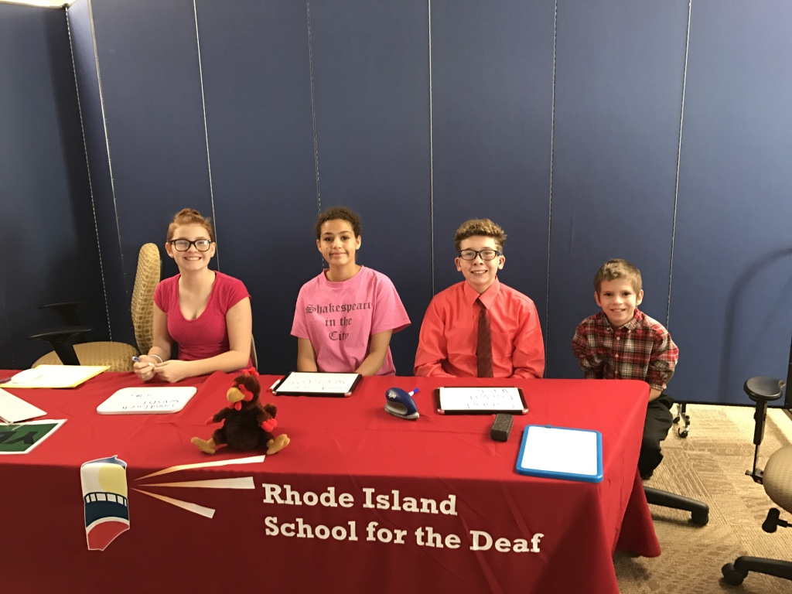
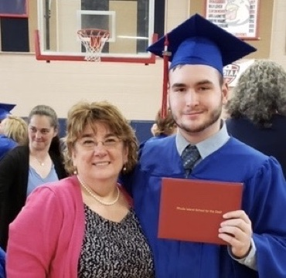
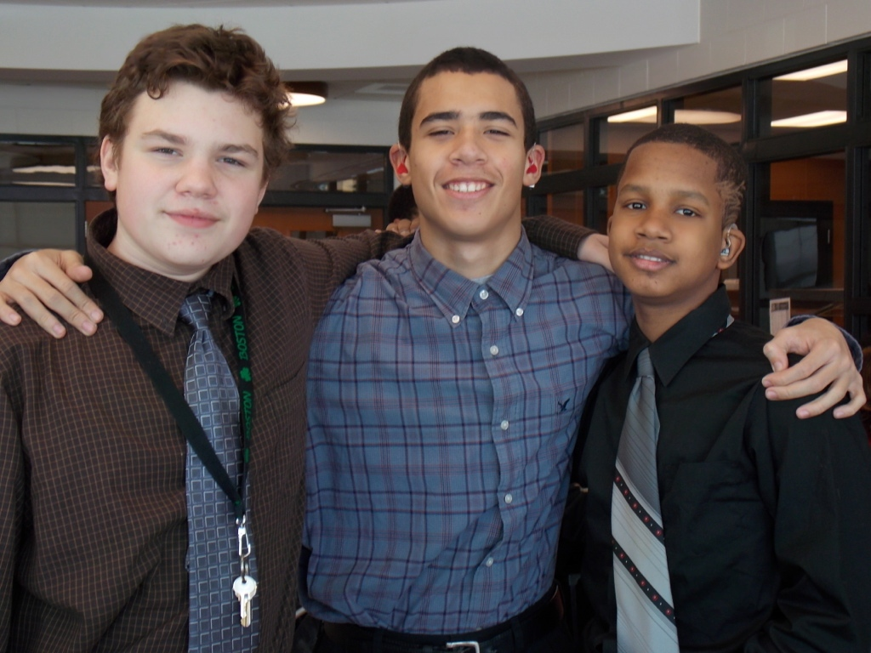
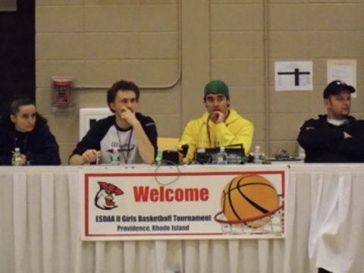
QUESTIONS?

