Slide 1
National Efforts to Reform Guardianship
Rhode Island Special Task force to Study Elderly Abuse and Financial Exploitation
March 6, 2019
Presented by: Diana Noel, MPA
Senior Legislative Representative

Slide 2
Why Guardianship Reform
Recent articles have spotlighted many holes in state systems that failed vulnerable adults from abuse and exploitation
Sixteen states haven’t had a revision since the 1980’s or earlier.
Rhode Island’s last major revision was in 1992.
People are living longer and there will be more people in a system that it’s not prepared to handle

Slide 3
Common Issues Across States
Caregiving
Funding for Public Guardianship
Elder Abuse/Financial Exploitation
Guardian Accountability and Court Monitoring
Individual Rights
Less Restrictive Alternatives to Guardianship
Lack of Good and Consistent Data

Slide 4
Challenges to Lasting Guardianship Reform
Increasing Need but Lack of Resources
Disconnect between policy and practice
Stakeholder Silos
Staffing and Turnover
Complexity of Cases

Slide 5
Reform Trends
Individuals, their family and friends are speaking up!
Person-centered approach
Alternatives to guardianship
Standards and training for ALL guardians
Increase in education and outreach
Monitoring reforms to prevent abuse/exploitation
More collaboration/taskforces/ multidisciplinary teams (ex. WINGS)
State courts are taking on a more active role
Increase in federal involvement/possible assistance to states

Slide 6
Examples
Connecticut:
2017: SB 967 requires standard of practice for conservators; also authorizes probate court administrator to conduct random audits of conservator accounts
created an online training module for family and professional conservators
Nevada:
2017: Supreme Court created the Permanent Guardianship Commission
2017: enacted legislation to create Guardianship Compliance Office
2018: GCO created a toll-free guardianship hotline
Texas:
First state to enacted supported decision making agreement as a less restrictive alternative to guardianship (2015, 2017)
Guardianship Compliance Project http://www.txcourts.gov/programs-services/guardianship-compliance-project/
AARP Texas and Texas Appleseed: “Managing Someone Else’s Money in Texas”
Notes:
2017: 49 enactments in 25 states
2018: 39 enactments in 22 states

Slide 7
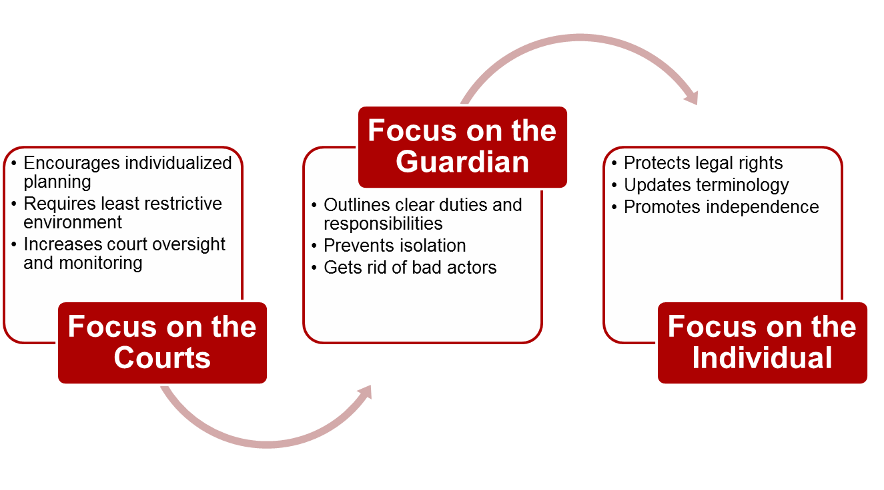
Uniform Guardianship, Conservatorship, and Other Protective Arrangements Act (UGCOPAA)
Approved by Uniform law Commission in July 2017
2018: Enacted in Maine and certain sections in New Mexico
Currently pending in Montana, Utah and Washington

Slide 8
Considerations for Rhode Island
Update terminology
Old: ward, alleged incapacitated person, incapacitated person
New: adult, respondent, adult subject to guardianship/conservatorship
Define less restrictive alternatives, like supported decision making agreements
Enacted in Alaska (2018), Delaware (2016), DC (2018), Texas (2015), Wisconsin (2018)
Currently pending in Kansas, Indiana and Rhode Island
Create a WINGS
Legislation in Montana and Kentucky
Can help to identify Rhode Island specific needs

