Slide 1

Rhode Island Air National Guard
Current Cyber Landscape
This Overall Classification of this Briefing is:
UNCLASSIFIED//FOUO
Major Christopher Allen
UNCLASSIFIED
UNCLASSIFIED

Slide 2
Executive Direction
Presidential Policy Directive/PPD-21 – Critical Infrastructure Security and Resilience (12 Feb 2013)
  National unity of effort to strengthen and maintain secure, functioning, and resilient critical infrastructure
Presidential Executive Order – Promoting Private Sector Cybersecurity Information Sharing (13 Feb 2015)
  Encouraging Private-Sector Cybersecurity Collaboration
  Enabling Better Private-Public Information Sharing
  Providing Strong Privacy and Civil Liberties Protections
Presidential Executive Order – Blocking the Property of Certain Persons Engaging in Significant Malicious Cyber –Enabled Activities (1 April 2015)
  Authority to respond to the threat posed by malicious cyber actors
UNCLASSIFIED
UNCLASSIFIED

Slide 3
Legislative Direction
The Protecting Cyber Networks Act (H.R. 1560) - April 2015
  Voluntary Information Sharing between private companies and federal government (non-DoD and NSA)
  Cyber Threat Indicators for Cybersecurity Purposes ONLY
  Congressional Oversight
National Cybersecurity Protection Advancement Act (H.R. 1731) April 2015
  Department of Homeland Security’s (DHS) center for integrating cyber threat information is the National Cybersecurity and Communications Integration Center (NCCIC)
    Solely to prevent and respond to cyber attacks
    Protect the privacy and civil liberties of all Americans
    Pro-privacy, pro-security bill ensures the sharing of cyber threats is transparent and timely
UNCLASSIFIED
UNCLASSIFIED

Slide 4
Department of Defense Direction
DoD
  Defend DoD networks, systems, and information
  Defend the United States and its interests against cyberattacks of significant consequence
  Provide integrated cyber capabilities to support military operations and contingency plans
USCYBERCOMMAND (USCC)
  DoD Cyber professionals will grow by 6000+ by FY 18
United States Air Force (USAF)
  AFSPC/24AF/67CW/26COG/33NWS
  ANGRC/102NWS
  JTF Cyber
Rhode Island (JTF Cyber/DHS?)
  RI JFHQ/102NWS
UNCLASSIFIED
UNCLASSIFIED

Slide 5

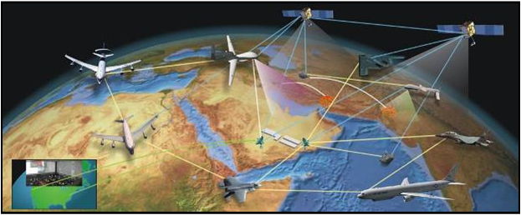

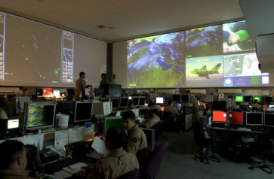
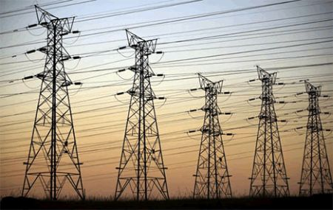
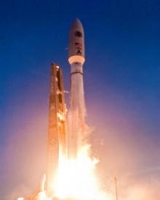

102 NWS Mission
  Citizen Airmen providing Active/Passive DCO & Intel capabilities to USCYBERCOM, USAF, DHS, FEMA Region I and RI to defend, deny, detect, analyze, research and report network intrusions and vulnerabilities.
UNCLASSIFIED//FOUO
UNCLASSIFIED//FOUO

Slide 6
USAF Requirements
Air Force Cyberspace Defense (ACD) Weapon System- Computer Network Defense Service Provider (CNDSP) for the AFIN
  24/7/365 monitoring of AF cyber domain
    Real-time response to and investigation of network/computer intrusions
    CNDSP for 3rd party enclaves
      COCOM
      AOC
      USAF/Joint R&D
Pro-active Defense and Defensive Counter Cyber – Pursuit (DCC-P)
UNCLASSIFIED
UNCLASSIFIED

Slide 7
Rhode Island Cyber Disruption Team (RI CDT)
Primary Role of ANG as member of RI Cyber Disruption Team
  Participate in Bi-Monthly meetings since 2012
  Summer 2014 participated in HOT SIM training with RI State Police
  Sponsor/Mentor for Cyber Patriot
  Multiple RI EMA cyber Tabletops
  Cyber Yankee 2015
  Limited to Train, Advise, Assist (TAA) Role
    Legal Limitations
    SAD Requirements – Direct EMA/CDT coordination
UNCLASSIFIED
UNCLASSIFIED

Slide 8
Military Capabilities
Cyberspace Operations Planning Team
  Integrates Cyberspace Ops in the Order of Battle
Defensive Cyberspace Operations Crew
  Detect/defend/deny adversary freedom of action in an AOR
  Supports Critical Infrastructure
  Analyzes/secures/creates affects to establish/maintain superiority
  Defends friendly info against adversary efforts
  Coordinated/integrates with air/space/cyberspace to enhance ops
Cyberspace Intelligence
  Information Collaboration/Sharing
  Preparation of Operational Environment
  Battle Damage Assessment
UNCLASSIFIED
UNCLASSIFIED

Slide 9
Cyber Skills Civilian Snapshot
DSG Civilian Positions
  Information Security Analyst
  Information Technology Manager
  Network Engineer
  Systems Engineer
  Computer Support Analyst
  Infrastructure Technician
  Technical Systems Analyst
Degrees
  Communications
  Information Systems
  Cyber Security
  Information Assurance
Certifications
  BIST
  CCNA
  CEH
  CISSP
  DISA Level 1
  GCIH/GSEC
  Security+
UNCLASSIFIED
UNCLASSIFIED

Slide 10
Emergency Support Functions (ESF)
1) Effects Delivery – These ESFs perform functions resulting in the direct delivery of life saving or property protection effects.
  1. ESF #3 – Public Works and Engineering
  2. ESF #4 – Firefighting (air and ground)
  3. ESF #6 – Mass Care, Emergency Assistance, Temporary Housing, and Human Services
  4. ESF #8 – Public Health and Medical Services
  5. ESF #9 – Search and Rescue
  6. ESF #10 – Oil and Hazardous Materials Response
  7. ESF #13 – Public Safety and Security
2) Enablers – These ESFs perform functions primarily in support of two or more of the Effects Delivery ESFs, enabling them to deliver lifesaving or property protection effects.
  1. ESF #1 – Transportation (air and ground)
  2. ESF #2 – Communications
  3. ESF #5 – Information and Planning (includes Emergency Management and Incident
UNCLASSIFIED
UNCLASSIFIED

Slide 11
Limiting Factors
Title and Authority (Legal)
  State Active Duty
  Title 32
  Title 10
Equipment Utilization
  RI-EMA/RI CDT procured RAPID-TAC equip (previous slides)
  Currently cannot utilize Federal Air Force Cyberspace Defense (ACD) Weapon System assets on critical infrastructure, OGA or civilian networks
  ANG to field VITE NLT FY17 for 10 National Cyber Units 102 NWS)
UNCLASSIFIED
UNCLASSIFIED

Slide 12
Critical Infrastructure
Academia, Civilian/Business, OGA, State Government, Utilities
Focus on interoperability, Training, Info Sharing
  Academia – MIT LL, Hanscom AFB
  Medical - Blue Cross Blue Shield RI, CVS Health
  Financial – Citizen’s Bank
  Insurance – FM Global, Amica
  Industrial/Utilities – National Grid
  Intellectual Property/PII – All, Dell
  Government – DHS, DIA, State of RI, NE Region
UNCLASSIFIED
UNCLASSIFIED

Slide 13
Questions?
UNCLASSIFIED
UNCLASSIFIED

