Slide 1

EOHHS Healthcare Workforce Transformation
Presentation to Special Legislative Commission on Older Adults

Slide 2
Workforce Challenges Across RI’s Health and Human Services Sector
Pre- and post-pandemic
Emotionally & physically exhausting work
Lack of respect and recognition
Lack of racial, linguistic, and ethnic diversity, especially in the licensed workforce
Workforce stress, burnout, and turnover across all settings and occupations
Uncompetitive reimbursement rates and wages
Limited opportunities & barriers to advancement
Tight labor market (“Great Resignation”; structural shortages)
…All of which have adversely impacted workforce recruitment & retention AND timely access to quality care and services for older adults.
Notes:
Emotionally and physically exhausting work. Espec BH; trauma; burnout care for caregiver. Sometimes undesirable a/o unpredictable hours. Concerns about health & safety.
Uncompetitive reimbursement rates and wages [Have not kept pace. Lose staff to other sectors (in/out of hc) and settings (eg, private practice)
Tight labor mkt: “Great resignation”; struct shortages (fewer people entering the workforce than leaving the workforce)
Lack of DEI – implicit bias: impact on workforce (unwelcoming/unsupportive), pt/client outcomes

Slide 3
Rhode Island’s Health Workforce Planning Initiative
Launched in April 2022 by EOHHS, OPC, and DLT at Health Workforce Summit
Over 600 individuals from 200+ organizations
Weekly public-private sector project team meetings
Workgroups and project implementation teams
Quarterly online update meetings attended by 125 – 150 stakeholders
Quarterly electronic newsletter sent to over 1,700 contacts
Three annual Summits (75, 125, and 155 attendees); two attended by Governor McKee
Notes:
Work started in April 2022 (two years before the HCSP Cabinet was convened)
From outset, focus has been on planning AND implementation, with a focus on actionable short-term and longer-term initiatives
Signif stakeholder engagement , which has informed EVERYTHING that we will share with you this morning.
Thank partners and participants in the room.

Slide 4
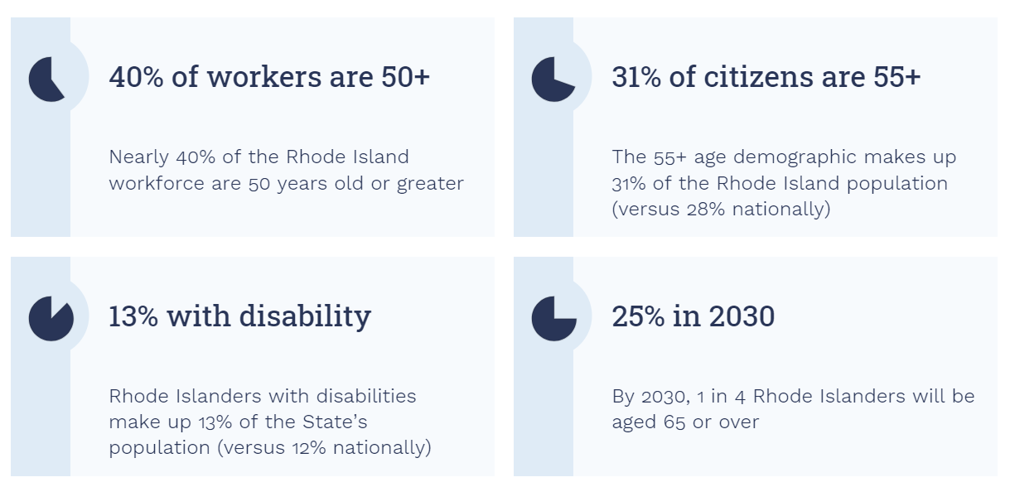
Aging in Rhode Island
By 2030, it is estimated that one in four Rhode Islanders will be 65 or older, while adults living with disabilities in Rhode Island account for 13 percent of the total state population, versus 12 percent nationally.
Notes:
Need for services and a workforce to deliver them will continue to increase – even as the current workforce continues to age out.

Slide 5
Direct Care Workers in Long-Term Care
Nursing Assistants (CNA) and Home Health & Personal Care Aides (PCA) are low paid, disproportionately women of color, and rely on some form of public assistance.
Employed Median wage White/Hispanic/Black Female/Male
Nursing Assistant . 8,040 $20.00/hr. 34% / 34% / 21% 93%/7%
Home Health & Personal Care Aide 8,370 $18.25/hr. N/A N/A
39% of Nursing Assistant and Home Health & Personal Care Aide (combined) receive some form of public assistance.
Long-term care settings compete for CNAs with other settings
Setting Earnings Employment Median Age
All long-term care $33,332 9,894 43.4
Home Care $26,340 3,952 43.9
Residential $36,632 6,661 43.2
Hospital $39,796 2,845 39.8
Government $51,076 506 48.8
Temporary employment $17,040 2,557 39.2
Growth in CNA employment (2019-2023): All healthcare settings: 1.4% Temporary employment: 37.2% (2,557)
50% of all CNAs working in a healthcare setting work in long-term care.
Sources: RI DLT; RI EOHHS; PHI National; All data is for 2023 unless otherwise note.
Notes:
CNA: $17.61 $20.00 $22.58 (min, median, exper)
HHA: $14.67 $18.25 $20.79 (min, median, exper)

Slide 6
Direct Care Workers in Long-Term Care
Thousands of actively licensed Nursing Assistants (CNA) are not working in healthcare or any job in Rhode Island.
Licensed: 17,890
Employed in a healthcare setting: 13,293
Employed in any setting: 15,400
There will be nearly 30,000 job openings for CNAs and PCAs between 2022- 2032.
Growth Transfers Exits TOTAL
Nursing Assistant 944 6,035 7,465 14,444
Home Health & Personal Care Aide 1,933 7,225 6,025 15,183
More than 2,200 new CNAs have been licensed in the past 12 months. And yet, there are currently 288 CNA jobs posted on EmployRI.
Very few CNAs go on to become Registered Nurses.
Of the 42,946 CNAs licensed since 2010, only 7.7% have gone on to become a Registered Nurse. This percentage is higher for White CNAs (12.3%), and lower for Black (3.9%), and Hispanic CNAs (3.2%)
Sources: RI DLT; RI EOHHS; RIDOH. All data is for 2023 unless otherwise note.
Notes:
Takeaway: We need to focus on recruitment AND retention!

Slide 7
Workforce strategies for Direct Care Workers
Rhode Island is developing and implementing multiple strategies to attract, train, and retain a diverse, skilled, and well-supported healthcare workforce.
Pipelines to Employment
CaringCareers.ri.gov
Recredentialling foreign-trained health professionals
Partnerships between Career & Tech Education and healthcare employers
Licensure system improvements
Pre-employment healthcare training programs
Career Pathways
Advanced certifications
Health Professional Equity Initiative
Ladders to Licensure
RI Reconnect
Wavemaker program
Health Professional Loan Repayment
Notes:
High level review of what we discussed – especially the gaps in the system and reimbursement, hospital boarding, workforce – 4-5 bullets ; data needs; state structures that support implementation and sustained work ; Office of Healthcare Planning or similar structure that plans – add structure s that support sustainability.

Slide 8
Workforce Strategies for Direct Care Workers
Rhode Island has is developing and implementing multiple strategies to attract, train, and retain a diverse, skilled, and well-supported healthcare workforce.
Workforce Data
EOHHS Healthcare Workforce Data Dashboard
Expanded health professional licensure data collection
DLT data dashboard
Rates and Wages
ARPA investments in workforce recruitment & retention
OHIC rate review; FY2025 increases in provider rates
Some related initiatives and partners in Rhode Island
Health Care System Planning • GWEP, LTCCC, AARP, HealthCentric Advisers • CTC Primary Care Workforce Taskforce, Community Health Worker Association • Developmental Disabilities • Community Health Worker Association • Oral Health
Behavioral Health (children and adults) • RI Foundation • Olmstead Planning • Higher Education (credit and non-credit)

Slide 9
Questions
Suggestions

