Slide 1
Nurse Licensure Compact:
Operations, Benefits and Current Status
Presentation before the Special Legislative Commission To Study And Provide Recommendations For Uniform Multi-State Nursing License Requirements
NCSBN State Affairs
Nicole Livanos, Director
MollyMaeve Lusk, Associate
Robert Krebs, Associate

Slide 2
Overview
The NLC Today
Operations
  Obtaining a multistate license
  Governance
  Discipline
  Workforce
  Cost
Benefits
  Telehealth
  Cost and administrative savings
Benefits cont.
  Facility flexibilities and workforce
  Disasters
  Patient access to care
  Diverse coalition of support
Current Status
News
Q&A

Slide 3
Where we are…
The NLC has been operational for over 20 years
Current membership:
  40 jurisdictions
    38 states
    Guam + Virgin Islands
COVID-19
  Licensure Waivers
  Ohio
  Pennsylvania
  Vermont
  Guam & Virgin Islands
Notes:
There are over 200 interstate compacts in the US.
Each state is member of an average of 25 compacts.
The NLC was the first interstate compact for a licensed profession.
Other healthcare professions have or are created interstate compacts for licensure, including medicine, PT, EMS, Psychology

Slide 4
Operations

Slide 5
Multistate Licensure and PSOR
Primary state of residence (PSOR)
Moving states
  Compact state → Compact state
    Retention of multistate privilege to practice
    Ease of transition
  Compact state → Non-compact state
    Loss of multistate privilege to practice
    Current negative impact on nurses moving to Rhode Island
  Non-compact state → Compact state
    Eligibility to apply for voluntary multistate license and gain privilege to practice across 40 jurisdictions

Slide 6
NLC Commission
Membership
  One representative from each party state; one vote
Rulemaking
  Limited to operation and governance of NLC
  No ability to change state licensure requirements, scope of practice laws, or disciplinary procedures
Ability to issue/renew licenses and enforce RI nurse practice act remains with RI BON
Similarity with other compacts*
*RI has enacted two healthcare compacts, the IMLC and PSYPACT
RI has pending legislation to join the ALSP-IC, Counseling Compact, PA Compact, and PT Compact

Slide 7
Discipline
Discipline in Primary State of Residence (PSOR)
  PSOR has disciplinary authority over a nurse’s license
  If disciplinary action is taken, a license is considered encumbered which is a disqualification for holding a MSL
Discipline in Party State
  Party state eligible to take action against a licensee’s privilege to practice within their borders

Slide 8
Discipline – Information Sharing
Party states are required to participate in a coordinated licensure information system
  Nursys
  Reporting requirements:
    Adverse action
    Significant investigatory information

Slide 9
Workforce – Data Collection and Continuing Education
(1) Beginning September 1, 2023, and annually thereafter, individuals that hold a multistate nurse license issued by a state other than Washington and are employed by hospitals licensed under this chapter shall complete any demographic data surveys required by the board of nursing in rule as a condition of employment.
(2) Individuals that hold a multistate nurse license issued by a state other than Washington and are employed by hospitals licensed under this chapter shall complete the suicide assessment, treatment, and management training required by RCW 43.70.442(5)(a) as a condition of employment.
(3) Hospitals shall report to the board of nursing, within 30 days of employment, all nurses holding a multistate license issued by a state other than Washington and an attestation that the employees holding a multistate license issued by a state other than Washington have completed the tasks required under this section as a condition of employment.
*Note: This section was repeated for all healthcare employers in the state. Subsequent sections named nursing homes, nursing pools, ambulatory surgical centers, etc.

Slide 10
Cost
Licensure fees
Annual fee
Investigations
Fee structure decided by party state
  One fee
  Multistate license fee
Other Compacts:
IMLC $700 to the Commission + state licensure fees in each state
PT Compact $45 to the Commission + optional state licensure fee (MS $150)
Psypact initial fee and renewal fee to commission

Slide 11
Benefits

Slide 12
Telehealth
2022: 1 in 4 patients accessed care through telehealth AMA
According to the American Telemedicine Association, 50% of healthcare services might be provided by telehealth within the next five years ATA
Individuals employed in telehealth industry grew 28.9% on average between 2018-2023 IBISWorld

Slide 13
Cost and Administrative Savings for Nurses
The NLC saves nurses money
  No need to pay licensure and renewal fees in each state of practice
The NLC reduces administrative headaches for nurses
  No need to obtain, hold, and renew multiple single-state licenses
  Eliminates waiting time for license approval

Slide 14
Interstate Facilities and Workforce Flexibility
Capability to meet acute needs with existing staff
  E.g., addressing short-term vacancies or responding to surges
Flexibility for staff to work across facility locations
  E.g., helping meet patients where they are
Ability for staff to begin work immediately upon arrival
  Eliminates waiting time for license approval

Slide 15
Disaster Relief
Nurses can cross state lines immediately to provide care during times of crisis, without waiting for a declaration of emergency
  Reduced administrative burden to license and vet incoming nurses
  Streamlined regulatory environment, not relying on piecemeal executive orders
  Increased ability for nurses to provide care where it is needed

Slide 16
Patient Access to Care
Expands access to nursing care across the country
  Essential for the health of underserved communities
American Association for Retired Persons (AARP)
  Enables seniors to seek care in the manner that meets their lifestyle needs
Case Management Society of America (CMSA)
  Enables nurse case managers to coordinate care for patients regardless of their location while ensuring they are appropriately licensed

Slide 17
Diverse Coalition of Support
In Alaska…
Tribal
  Alaska Native Tribal Health Consortium
  Alaska Native Medical Center
Business & Local Government
  Alaska Chamber of Commerce
  Alaska Department of Commerce
Public Health
  Alaska Public Health Association
Payers
  Premera Blue Cross Blue Shield Alaska
Professional Associations
  Alaska APRN Alliance
  Alaska State Medical Association
Nursing Schools
  Alaska Pacific University School of Nursing
Specialty Home & Community Services
  Alaska Association on Developmental Disabilities
Aging Population
  Alzheimer’s Resource of Alaska

Slide 18
Current status

Slide 19
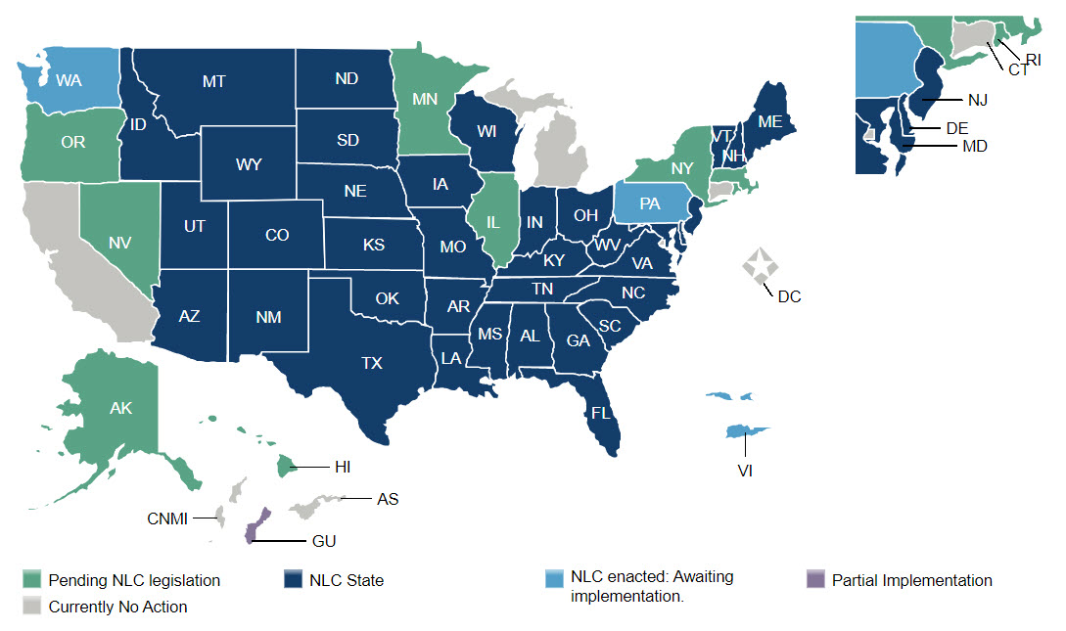
2023 Enactments:
Washington State
2023 Bills:
Alaska
Hawaii
Illinois
Massachusetts
Minnesota
Nevada
New York
Oregon
Rhode Island

Slide 20
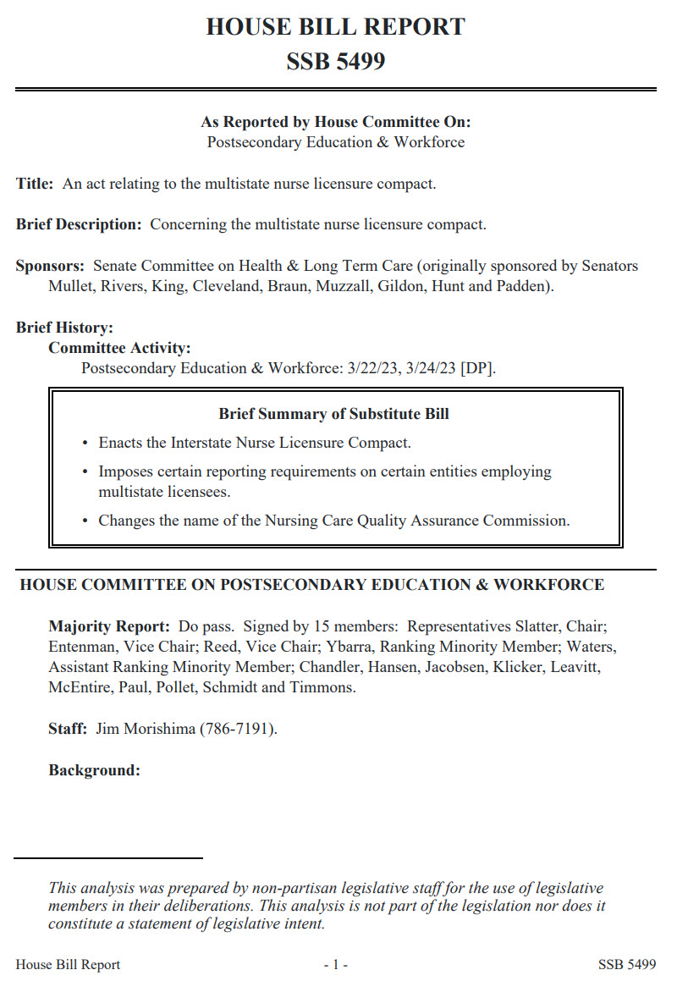
Session Highlights
Washington
  NLC enactment in April
  “(Opposed) None.”
    House Bill Report SB 5499
  WA becomes 40th jurisdiction

Slide 21
Session Highlights
Nevada
  NLC sponsored by Assembly Committee on Labor and Commerce
    Championed by Dem. Majority Leader Jauregui
  Key stakeholder: Nevada Nurses Association
New York
  Dem. Governor Kathy Hochul called for enacting the NLC in her State of the State address and agenda
  NLC introduced in Governor’s budget in 2022 and 2023
  Key stakeholder: ANA-New York

Slide 22
Study Efforts
Hawaii
  Dem. Senate leadership championed concurrent resolution in the 2023 session
  Hawaii Center for Nursing to convene workgroup to study NLC
Massachusetts
  Nonpartisan Health Policy Commission (HPC) charged with studying NLC in 2021
  HPC recommends state enact NLC

Slide 23
news

Slide 24
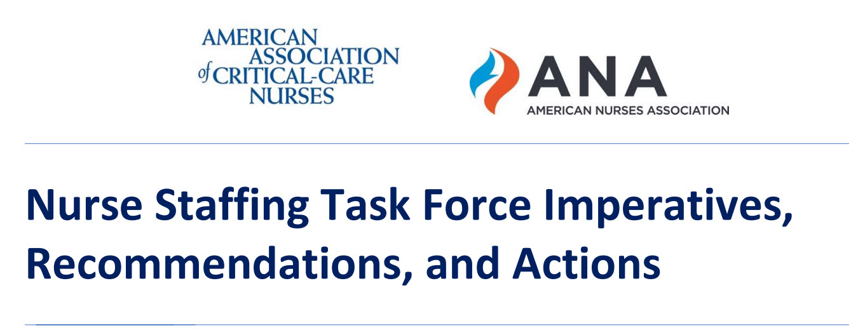
Hot off the press!
Imperative: Improve Regulatory Efficiency
  “2. Explore the expansion of the Nurse Licensure Compact to additional states/territories as a mechanism for reducing regulatory burden”
https://www.nursingworld.org/~499b62/contentassets/568122c62ddc44bea03b11a71f240a50/nurse-staffing-task-force-imperatives-recommendations--actions.pdf

Slide 25

Future of Nursing 2020-2030
Capitalizing on Nurses’ Potential
Recommendation 4: Remove barriers including regulatory and public and private payment limitations; restrictive policies and practices; and other legal, professional, and commercial impediments.
  Specific Actions: Federal authority (e.g., Veterans Health Administration regulations, Centers for Medicare & Medicaid Services [CMS]) should be used where available to supersede restrictive state laws, including those addressing scope of practice, telehealth, and insurance coverage and payment, that decrease access to care and burden nursing practice, and to encourage nationwide adoption of the Nurse Licensure Compact.

Slide 26
Thank You!

