Slide 1
Rhode Island Health Care Association
A Workforce Crisis in Long Term Care
Presented by Katie Norman, Vice President
March 21, 2023

Slide 2
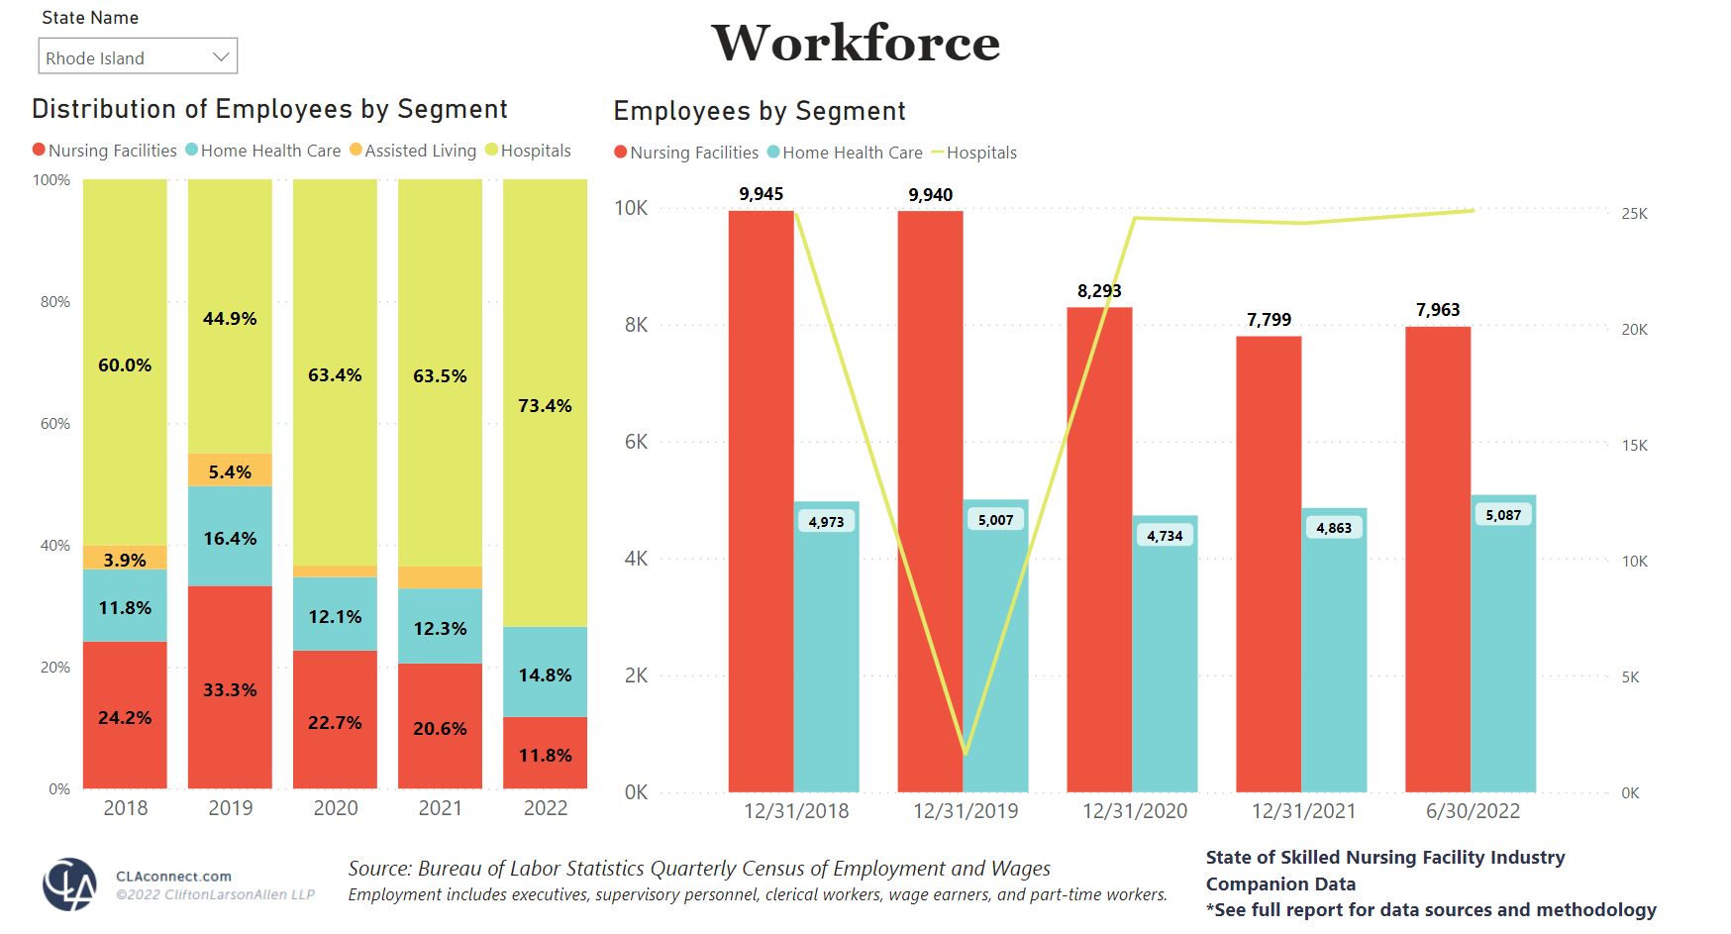
Workforce Shortfalls in Rhode Island Skilled Nursing Facilities
Rhode Island Skilled Nursing Facilities remain 20% below their workforce needs per a recent study conducted by accounting firm Clifton Larson Allen.
Home Health and Hospitals have returned to pre-pandemic staffing levels…

Slide 3
Impacts of Staffing Shortages and Unfunded staffing Mandate
Nearly 60% of Rhode Island Nursing Facilities have limited or considered limiting admissions since January 1, 2023.
70% of Rhode Island Nursing Facilities were unable to meet the unfunded staffing mandate in the second quarter of 2022, which would have resulted in 11.4 million dollars in fines per RIDOH
60% of Rhode Island Nursing facilities would have been on an admission freeze currently if the unfunded staffing mandate penalties were in effect
It is estimated that fines in year one alone as a result of the unfunded staffing mandate would be $60 million.

Slide 4
Hours worked by licensed nurses in Rhode island nursing homes
Based on PBJ Reports from Quarter 3 of 2022
76 Facilities Reported
900,000 RN Hours
604,100 LPN Hours

Slide 5
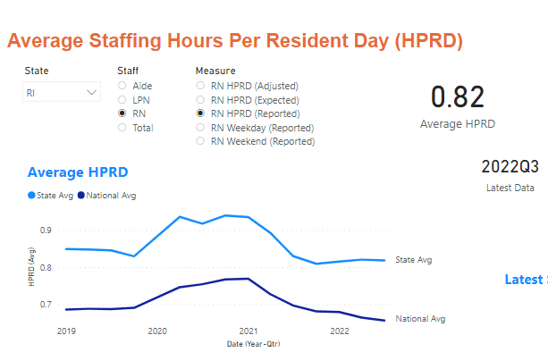
Nurse hours worked per patient per day in Rhode island nursing facilities
Based on Quarter 3, 2022 CMS Payroll Based Journal Data (76 Reporting Nursing Facilities)
RI significantly above the National Average

Slide 6
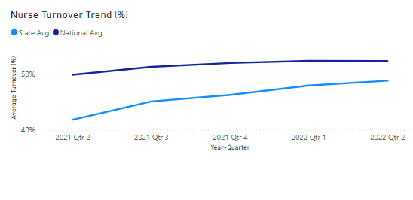
Retention of Nurses in Rhode Island nursing facilities
Based on Quarter 3, 2022 CMS Payroll Based Journal Data (76 Reporting Nursing Facilities)
RI Nursing Turnover: 48.8%
Flaws in CMS Turnover Number

