Slide 1


Rhode Island Department of Corrections (RIDOC)
Analytical Review of Female Offenders held/incarcerated in RIDOC’s
Women’s Facility 1
Wayne T. Salisbury Jr.
RIDOC Acting Director
Department of Corrections

Slide 2
Department Overview

Slide 3
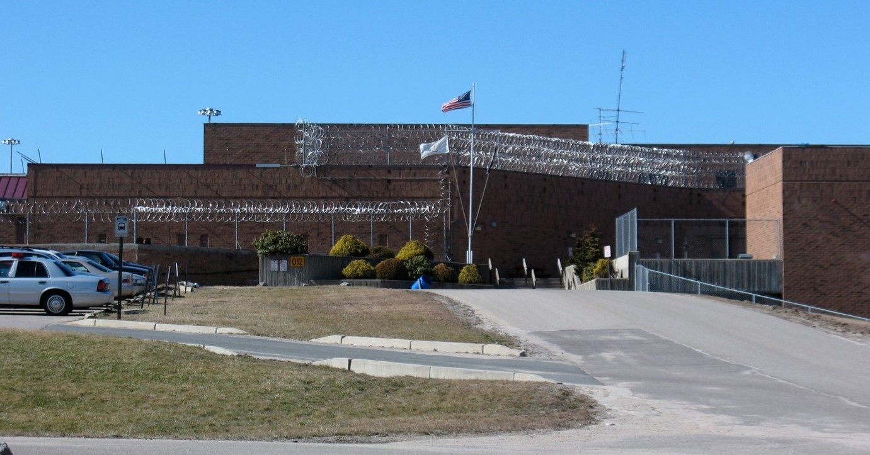
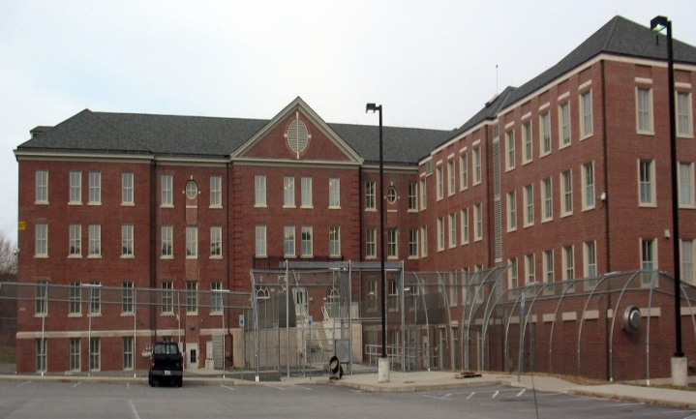
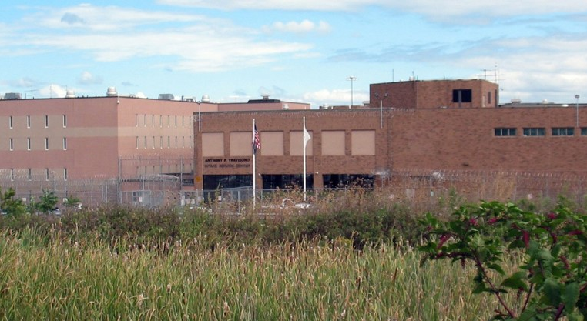
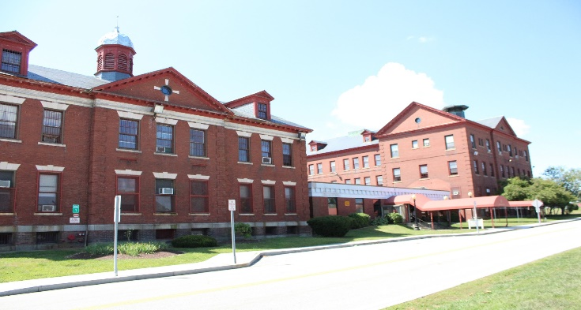
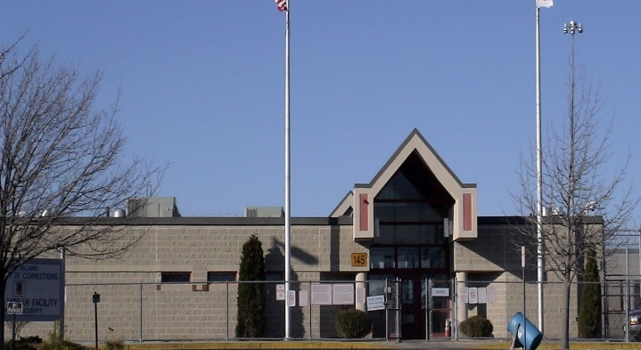
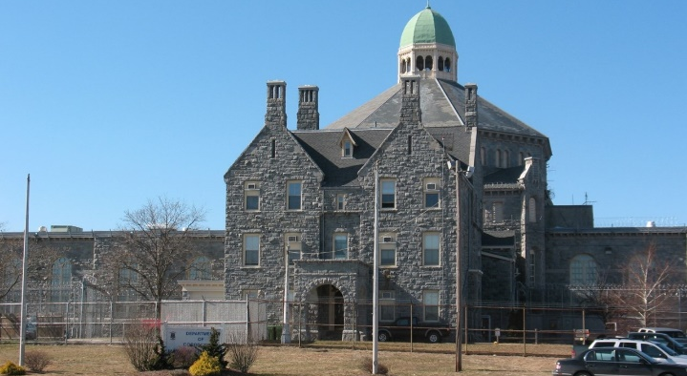
Adult Correctional Institutions
Women’s Facility 1
The Adult Correctional Institutions (ACI) at the Rhode Island Department of Corrections (RIDOC) are comprised of 6 offender facilities which are all located within 1 square mile in Cranston, RI. In Fiscal Year (FY) 2023, RIDOC had an average custody of 2,298 total people. Of those, 709 are awaiting trial while 1,573 are serving a sentence (15 other offenders are held due to civil purge, federal, and miscellaneous holds).
Intake Service Center
Minimum Security
High Security
Medium Moran
Maximum Security

Slide 4
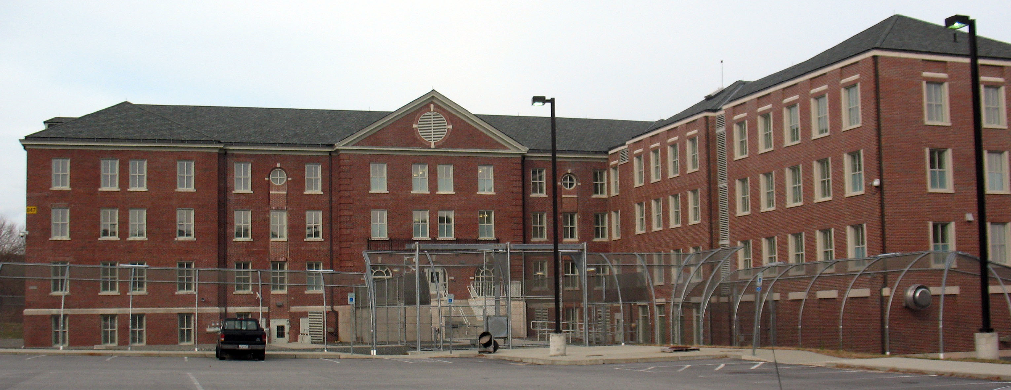
Women’s Facility 1
RIDOC’s Women’s Facility 1 (Gloria McDonald Building) is utilized to house incarcerated females who are held awaiting trial and those who are incarcerated serving a sentence.
Women’s Facility 1 contains three classification levels (medium, minimum, and work release).
In Fiscal Year 2023, Women’s Facility 1 had an average custody of 122 total people. Of those, 56 are held awaiting trial while 63 are incarcerated serving a sentence (3 other offenders are held due to a federal hold)
    122 total incarcerated females comprise just over 57% of the Facilities’ Palmigiano Capacity (213 offenders).
The annual cost per offender was $172,479.
Data Caveat: Palmigiano Capacity: Refers to the capacity established in federal court which mandates the number of offenders that RIDOC can safely detain. RIDOC’s Palmigiano Capacity is calculated with a formula that utilizes the total number of available beds.

Slide 5
Awaiting Trial Commitments
In Fiscal Year 2023, RIDOC had 1,345 female awaiting trial commitments.
Nearly 37% (n=500) were committed for violent offenses, 34% (n=452) were committed for non-violent offenses, 24% (n=325) were committed for drug offenses, and 4% (n=54) were committed for Breaking & Entering.
Data Caveat: The bar graph (shown above) excludes 1% of awaiting trial commitments who were admitted for sex offenses or held on pending charges.

Slide 6
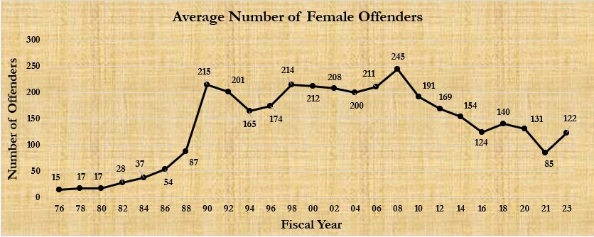
Historic Female Population at RIDOC
The population of the Women's Facilities at the Rhode Island Department of Corrections has fluctuated over the years. The female population was at its lowest with an average of 15 offenders in 1976 and peaked at 245 in 2008.
As of FY23, the female population has increased from decline caused in large part due to the first and second wave of COVID-19, yielding an average of 122 incarcerated females.

Slide 7
Awaiting Trial Releases
In Fiscal Year 2023, RIDOC had 1,344 female awaiting trial releases, of which 1,326 (99%) were released from Women’s Facility 1.
The bar graph (shown below) highlights the majority are admitted for violent offenses (489 or 37%), followed by non-violent offenses (449 or 34%), and drug offenses (318 or 24%).
The average pre-trial length of stay is about 17 days, with a median of just 3 days. The table (shown below) provides a breakdown of this data by most serious offense type.
Data Caveat: Awaiting Trial Release data (shown above) reflects female release events from Women’s Facility 1. The bar chart (shown above) excludes 1% of awaiting trial releases who were committed for sex offenses or held on pending charges.
Most Serious Offense Type | Average Length of Stay (in Days) | Median Length of Stay (in Days)
Violent | 20 | 8
Non-Violent | 9 | 2
Drug | 21 | 6
B&E | 21 | 5

Slide 8
Sentenced Commitments
In Fiscal Year 2023, RIDOC had 271 female sentenced commitments.
Just over 62% (n=169) were committed for non-violent offenses, 27% (n=74) were committed for violent offenses, and about 8% (n=21) were committed for drug offenses.
Data Caveat: The bar graph (shown above) excludes 3% of sentenced commitments who were admitted for Breaking and Entering (2%) sex offenses (less than 1%).

Slide 9
Sentenced Releases – Expiration of Sentence
In FY23, RIDOC had 243 female sentenced releases who had expired their sentence, of which 202 (83%) were released from Women’s Facility 1. The bar graph (shown below) depicts the majority were serving for non-violent offenses (58% or 117).
The average sentence length was about 104 days, while the median was nearly 56 days. The table (shown below) highlights that the majority of sentenced releases (84% or 169) had been serving a total sentence of 6 months or less. Only 2% (5) were serving a total sentence of 2 years or greater.
Data Caveats: Sentenced Release data (shown above) reflects female sentenced release events who 'expired their sentence' from Women’s Facility 1. Please note this excludes those who were admitted as 'parole violators', 'return from Eleanor Slater State Forensic Hospital', 'return from Escape', and 'return from Out-of-State'. These excluded cases skew the effects of sentence reduction credits (such as good time) as offenders who leave on parole do not achieve the full benefit of good time and offenders who return to RIDOC to continue a sentence do not calculate an accurate time served.
Total Sentence Length (in Days) | Percentage
1 Month or Less | 41%
1 Month - 6 Months | 43%
6 Months - 1 Years | 10%
1 Years - 2 Years | 3%
2 Years or Greater | 2%

Slide 10
Sentenced Releases – Expiration of Sentence
Sentence reduction credits (such as good time and program time) may reduce the overall length of stay/percentage of time that an incarcerated person serves on their sentence. The table below demonstrates how the accumulation of sentence reduction credits leads to those serving on violent or drug offenses (who have the highest average total sentence lengths of all most serious offense types) yield the lowest average percent of time served.
Most Serious Offense Type | Average Total Sentence (in Days) | Average Length of Stay (in Days) | Average Percent Time Served
Violent | 205 | 149 | 87%
Non-Violent | 89 | 71 | 92%
Drug | 214 | 159 | 80%
Data Caveats: Sentenced Release data (shown above) reflects sentenced release events who 'expired their sentence' from Women’s Facility 1. Please note this excludes those who were admitted as 'parole violators', 'return from Eleanor Slater State Forensic Hospital', 'return from Escape', and 'return from Out-of-State'. These excluded cases skew the effects of sentence reduction credits (such as good time) as offenders who leave on parole do not achieve the full benefit of good time and offenders who return to RIDOC to continue a sentence do not calculate an accurate time served. Lastly, due to the small sample size, the figures above exclude 4 sentenced releases for Breaking & Entering.

Slide 11
Sentenced Releases - Parole
Parole Release:
  Conditional early release of offenders sentenced to ACI for more than 6 months.
  Consideration is made at 1/3 of the prison sentence.
  Except Life, Lengthy or Murder sentences as specifically provided by statute (RI Gen. Laws § 13-8-13).
  The parole permit entitles the offender to be at liberty during the remainder of his/her term of prison sentence upon express terms and conditions prescribed by the Board.
Medical Parole:
  (RIGL §13-8.1-1 et. seq.) Medical parole is made available for humanitarian reasons or to alleviate exorbitant medical expenses associated with offenders whose chronic and incurable illness render their incarceration non-punitive and non-rehabilitative.
In FY23, RIDOC had 10 female sentenced releases who were discharged from RIDOC via parole, of which 5 were serving time for violent offenses and 3 were serving time for B&E offenses.
The average total sentence length was 3.8 years (1,387 days), with 5 females serving sentences of about 1 year and 5 females serving sentences of 2 years or greater.

Slide 12
Commitment and Releases – Summary
Commitments and releases capture the flow of the offender population into and out of Women’s Facility 1.
In months where commitments out pace releases, an uptick in the average female population is realized.
The inverse of the above statement is true in months where releases out pace commitments, leading to a decline in the average female population.
The majority of awaiting trial commitments and releases were admitted for violent offenses, whereas most of the sentenced commitments and releases were committed for non-violent offenses.
The vast majority of females committed and released throughout the Fiscal Year had relatively short lengths of stay in Women’s Facility 1.
As a result, many incarcerated females are released from Women’s Facility 1 before they have been able to obtain the full benefit of available institutional programs and course offerings.

Slide 13
Awaiting Trial and Sentenced Stock: 06/30/2023
At the close of Fiscal Year 2023, Women’s Facility 1 had 126 offenders:
    62 people held awaiting trial
    64 sentenced people
The bar graph below depicts the majority of those sentenced were serving for violent offenses (47% or 30)
The average total sentence length was 1,746 days (4.8 years), while the median was 548 days (1.5 years).
The table below highlights most female sentenced persons (60% or 36) were serving sentences of 2 years or less.
Total Sentence Length (in Days) | Percentage
1 Month or Less | 10%
1 Month - 6 Months | 13%
6 Months - 1 Years | 22%
1 Years - 2 Years | 15%
2 Years - 5 Years | 17%
5 Years - 10 Years | 10%
10 Years or Greater | 13%
Data Caveats: Stock data (shown above) reflects female offenders held awaiting trial and incarcerated in Women’s Facility 1 (as of 06/30/2023). The bar graph does not display data labels for most serious offense types that yield less than 4%. Please note the ‘Total Sentence Length’ table excludes 4 offenders serving a life sentence.

Slide 14
Awaiting Trial and Sentenced Stock – Summary
At the close of Fiscal Year 2023, the majority of awaiting trial (44% or 27) and sentenced incarcerated females (47% or 30) were incarcerated for violent offenses.
In stark contrast to commitments and releases, there is a stacking effect of violent sentenced females with lengthy sentences (10 years or greater) that impacts the resulting average total sentence statistics. The table (shown below) highlights that violent offenders have considerably longer sentences than those incarcerated for non-violent and drug offenses
  This context helps to explain why there is a significant difference when comparing the average total sentence length (8.7 years) with the median total sentence length (5 years).
  The median provides the middle case value and is a more accurate reflection of sentence length in the sentenced population, since unlike the average, is not adversely impacted by extreme case values.
Most Serious Offense Type | Average Total Sentence (in Days) | Median Total Sentence (in Days)
Violent | 3,188 | 1,826
Non-Violent | 343 | 319
Drug | 666 | 365
Data Caveat: Due to the relatively small sample size, the table (shown above) excludes 3% of female offenders who incarcerates for sex offenses.

Slide 15
CY19 Recidivism Rates
RIDOC defines a recidivist as a person released from a sentence who either returns as a sentenced offender or an awaiting trial detainee within 36 months of release.
A release cohort for calendar year 2019 (CY19) was followed for three years post release (through the close of CY22 to gauge success. If an offender can stay in the community for 36 months, they are considered successful as their likelihood to return greatly diminishes as time progresses.
Unlike most corrections departments, this gives RIDOC the unique ability to report recidivism rates for those who return to await trial in addition to those who return as sentenced offenders.
  The table (shown below) highlights that females yield lower awaiting trial and sentenced recidivism rates when compared with their male counterparts.
  The following variables were significantly correlated to recommitment rates: Age at release, education level, offense type, security level at release, and risk assessment score.
Breakdown by Sex | Awaiting Trial Recidivism Rate | Sentenced Recidivism Rate
Males | 55% | 46%
Females | 49% | 34%
Total (overall) | 54% | 45%
Data Caveat: Please reference RIDOC’s Annual CY19 Recidivism Brief for all applicable caveats.

Slide 16





Focus Areas
During Incarceration |
Post-Release
Job Training
Discharge Planning
Medicaid Enrollments
Probation Terms
Employers
- Training for jobs relevant in today’s marketplace
- Focus on the female population
.
- Early Termination
- Modification of Conditions
- Who are they?
- What do they need?
.
- High turnover rates

Slide 17
Transitional Services &
Discharge Planning
Make the process smoother and more effective- client’s needs, recidivism reduction, community and victim safety
Prepare the client for release by
  Providing available community resources and programing
  Addressing post-release needs
  Role modeling & motivating for prosocial behavior change and alternatives
Reducing potential barriers to successful reintegration
  Collaboration with community and state agencies
Be mindful of our client’s concerns and their reality, their returning situation

Slide 18
Community Corrections Assessment Analysts (CCAAs), Specialized Discharge Planners (SDPs), Information Services Technicians, VA/Office Veteran Affairs
Sentenced Adults in Custody (AIC) to be released within 9 months
  due to current good time date or granted parole month
    10 days or more in custody
    Less than 10 days
The awaiting trial population is primarily assisted on a case-by-case basis working in collaboration with the Public Defender’s Office and defense attorneys.
    They identify the needs, provide the confirmed court release date
AIC opt-in to accept reentry services

Slide 19
Any non-DOC, DOC staff or community person can send questions or referrals via Doc.TransitionalServices@DOC.RI.GOV
  To build collaboration, awareness and information sharing, we may include relevant staff such as the Facility Adult Counselor, Mental Health Clinician, and Probation/ Parole Officers when responding to emails. If the client is already assigned a CCAA and/or a SDP, they are also included
AIC can call *5632 (free) from any facility to speak with a staff member Monday-Friday 8:30 AM- 4 PM. Questions or concerns can also be mailed to us via “Facility Request Forms”
CCAA’s and SDPs meet with their assigned clients
Additionally, Thursdays, one clerical person visits Women's mods providing an opportunity to answer questions, share information, follow up, etc.
CCAAs partake in facility meetings
  EVERYONE (AWAITING TRIAL OR SENTENCED) IS WELCOME TO STOP BY OUR OFFICES AND EXIT CENTER FOR ASSISTANCE POST-RELEASE

Slide 20
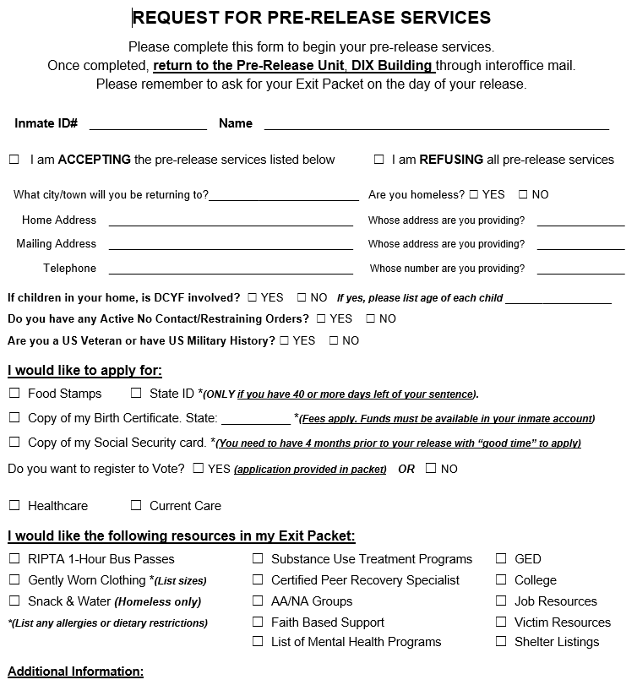
The process begins by providing a Pre-Release Packet (PRPs)
  If a CCAA or Discharge Planner, is assigned, it can be provided in person
  If no CCAA or DP is assigned), then provided via inter-facility mail by the Pre-Release Unit
    If clients require assistance completing the PRP, a staff member will meet with them and assist
Needs Assessment Form
Included in the PRP
Captures needs and requests for the Exit Packet
Exit Packet (EP)
Prepared by a CCAA, DP or the PRU
Contains appts, documents*, requested resources
On release day, the exit packet is at the facility the AIC was housed in
If the PRP is returned late, or too close to release day, applications are included
  *Document applications are subject to approval by the issuing agency- the DMV, Social Security Administration, etc.

Slide 21

We provide- (mostly through donations)
Gently worn clothing
Limited quantities:
Toiletries
Some backpacks & string bags
Recovery House Bags include new pillow, towel, sheets, blanket, toiletries, etc. for indigent clients going to a recovery house. (very limited number available)
Emergency snacks & water (donations & small nutrition pilot)

Slide 22


Slide 23
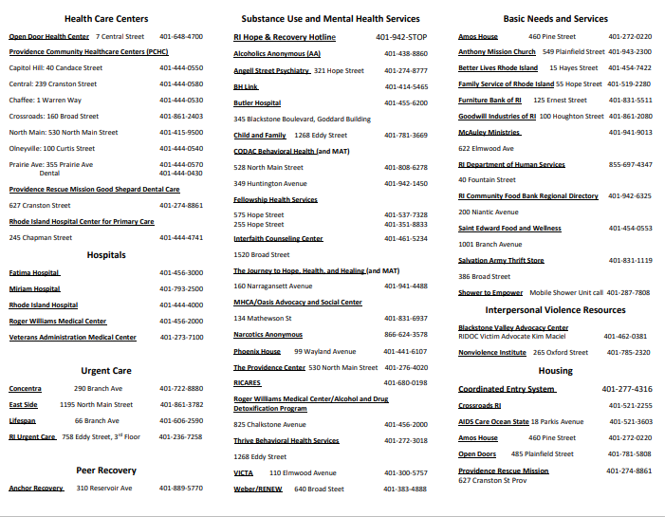

Slide 24
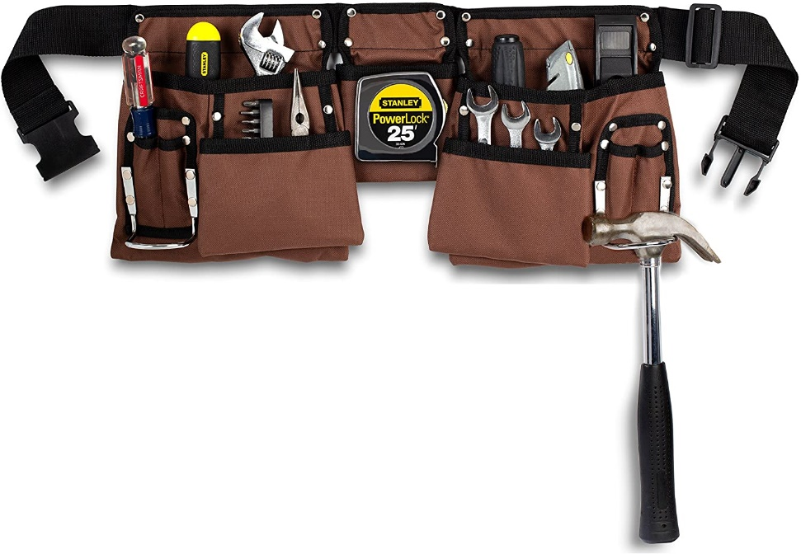
  COMPLEX BARRIERS
  Housing
    Systemic access
  State/federal benefits Enrollment
    Current process
    SNAP card
    SOAR specialist
  Healthcare
    Key component – MDP
    Referrals to providers of behavioral health or physical health
  CBT, Job training & placement
  Connections to social determinants of health
    Support services- statewide- specific regionals wraparound services -strengthening peer support programs
    Transportation

Slide 25


It is pretty much having everything on your shoulder versus depending on an entire team
-Asbanti
Not handing off…we need to
unite adult counselors, clinicians, P&P, agencies & the community to our client

