Slide 1
Reefs to Protect Beaches

Slide 2
RI is experiencing sea level rise and shore erosion
South Kingstown infrastructure in danger
Newport water supply at risk
Charlestown Breachway compromised in winter 2023 – 24
Matunuck Beach Rd and Ocean Mist threatened

Slide 3
300 feet of beach lost in Matunuck since 1939

Slide 4
Newport drinking water supply in danger

Slide 5
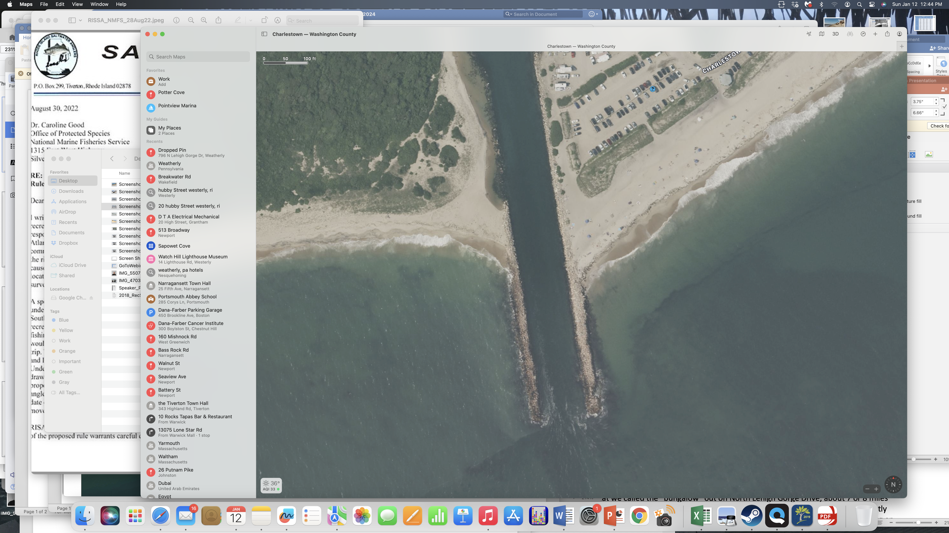
Charlestown Breachway Damaged

Slide 6
Potential help from reefs
URI ocean engineering professors have great expertise
Dr. Stephan Grilli, Dr. Annette Grilli, Dr. Che-Wei Chang
Modeling shows that with properly designed reefs erosion greatly reduced
Actual reefs have proven effective in many areas worldwide
Kelp adds to the protection and improves ecology

Slide 7
Reefs are Proven to Protect Beaches
The United States Geological Survey (USGS) states that coral reefs prevent over $1.8 Billon in property damage every year in the US.
Port of Rotterdam reefs protect shore & create habitat
Florida states that artificial barrier reefs protect from sea level rise
Stratford Point living shoreline with reefs in CT
TNC Crescent beach project, RI

Slide 8
Why is RISAA Involved?
Representing over 7500 saltwater anglers we have many members who are losing access to shore fishing from erosion
New reef structures will provide habitat for fish
Re-establishing kelp along the RI south shore provides shelter
New reefs would allow fishing close to port
Enhanced opportunities for snorkeling and diving

Slide 9
Hard structure such as a reef becomes fouled with organisms and offers shelter for juvenile and adult fish and invertebrates

Slide 10
Similar reef structures can be designed for high energy environments such as the RI South coast

Slide 11
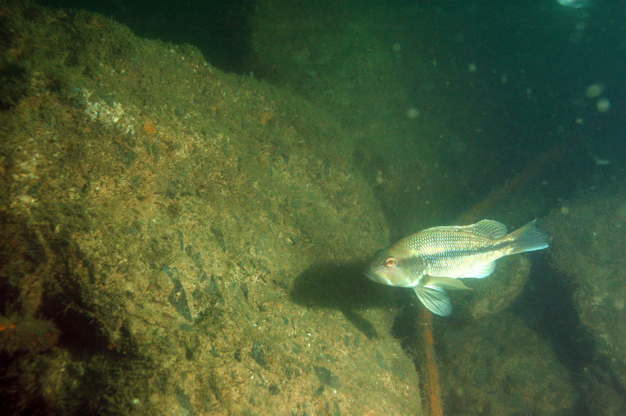
Within months debris from the Jamestown Bridge was beginning to foul and was populated with fish

Slide 12
Ecological benefits help all fishing
Because Artificial Reefs offer such a great increase in biological carrying capacity they enhance all fisheries in the area, including commercial fisheries

Slide 13
Opportunities for collaborative project
Support from local communities
Collaboration with recreational fishing groups and commercial fishing groups
Federal agencies with mission to protect coastal communities are likely to support
Initial funding from multiple sources

Slide 14
The Nature Conservancy
RISAA has partnered with TNC on projects in RI
TNC has experience here and around the world
TNC has installed AR projects to improve habitat in RI
TNC has completed projects to reduce erosion in RI
John Torgan, State Director for TNC will give more details

