Slide 1
Misquamicut Beach Nourishment A pilot program for RI Beaches

Slide 2
AGENDA
The Problem
The History
Who does this affect?
Video
Call for Action

Slide 3
sea level rise climate change barrier BEACH frequent storms Public access
The problems:

Slide 4
Storms and erosion
We lose shoreline each year even in a normal winter
Barrier beaches want to move
Hurricanes and Super Storms ravage the beach and infrastructure
Now even a regular Nor’ Easter or wind and rain event causes hurricane like damage and flooding
Insurance is hard to get and very expensive

Slide 5
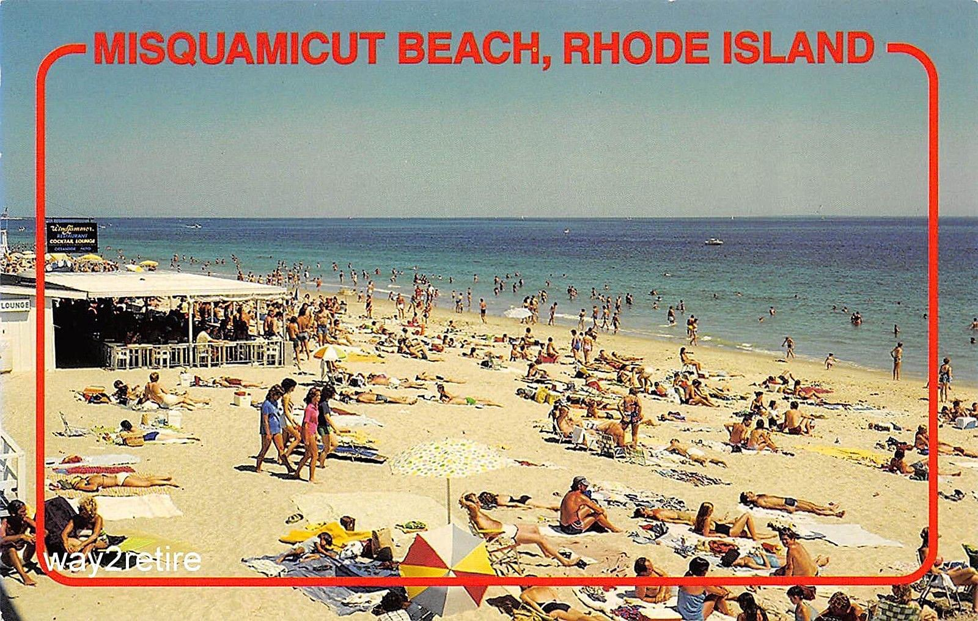

Slide 6
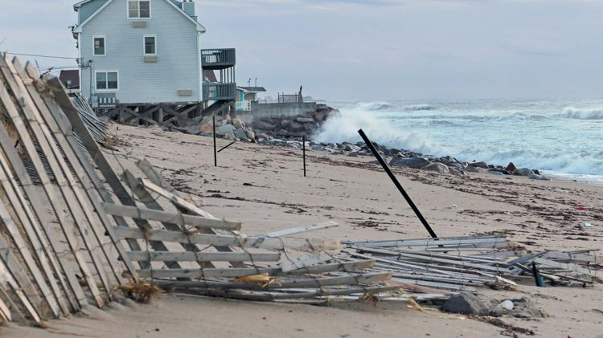

Slide 7
Mitigation has been haphazard
Dredge project of pond only placed sand on the state beach which proved ineffective
Raising of structures helps but is not a long-term solution
No proposals take the whole stretch of beach into account- it is all separate and piecemeal: State portions, fire district portions, town portions, business portions and residential portions

Slide 8
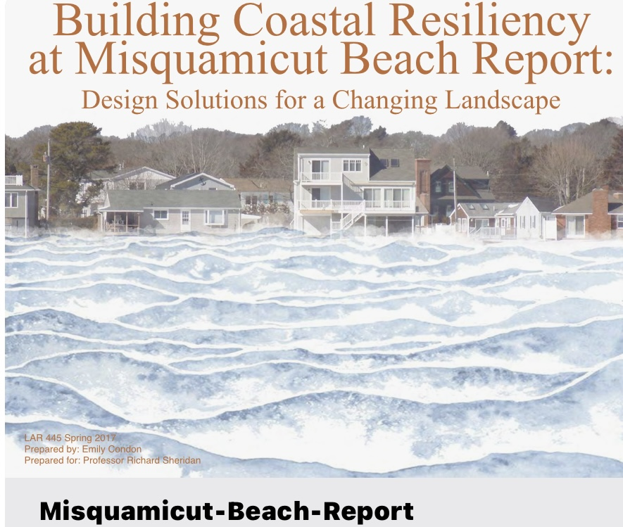

Slide 9
SELECTING VISUAL AIDS
ENHANCING YOUR PRESENTATION

Slide 10
Flooding and sand displacement

Slide 11
Who does this affect
Residents
Businesses
Public Access
Westerly Taxpayers
Local and State Economy
Town & State Property
Fire District

Slide 12
Loss of parking-largest in the state
2700 Parking spaces at State Beach alone
2000 additional parking spaces
Nearly 5000 parking spaces at the beach, the largest in the state

Slide 13
What will we lose?
Vicinity of 9 million dollars annual in property taxes to the town
Roughly 1500 seasonal jobs
50 businesses
Approx 215 homes
Town Beach & State Beach Pavilions
Two trailer Parks
Loss of millions in hotel and meals tax and State Beach parking that go to the Town and State
Access

Slide 14
The Numbers
Parking revenue 2.4 million per season
1.2 million of that is State Beach
10 million in hotel revenue
1 million in Hotel Tax shared by the town, state and tourism district
1.3 million in meals/beverage tax for Westerly of which Misquamicut is a major contributor
9.1 million in sales tax for Westerly from Restaurants of which Misquamicut is a major contributor
Retail sales tax
Gas tax

Slide 15
JOBS
Approx 1500 seasonal jobs
15 weeks equals $13, 500,000 in gross wages
Out of that approx. 1.41 million is federal and state taxes which includes Social security tax, Medicare tax, Federal and state unemployment tax

Slide 16
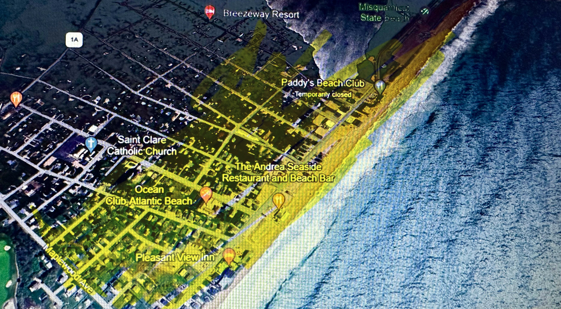

Slide 18
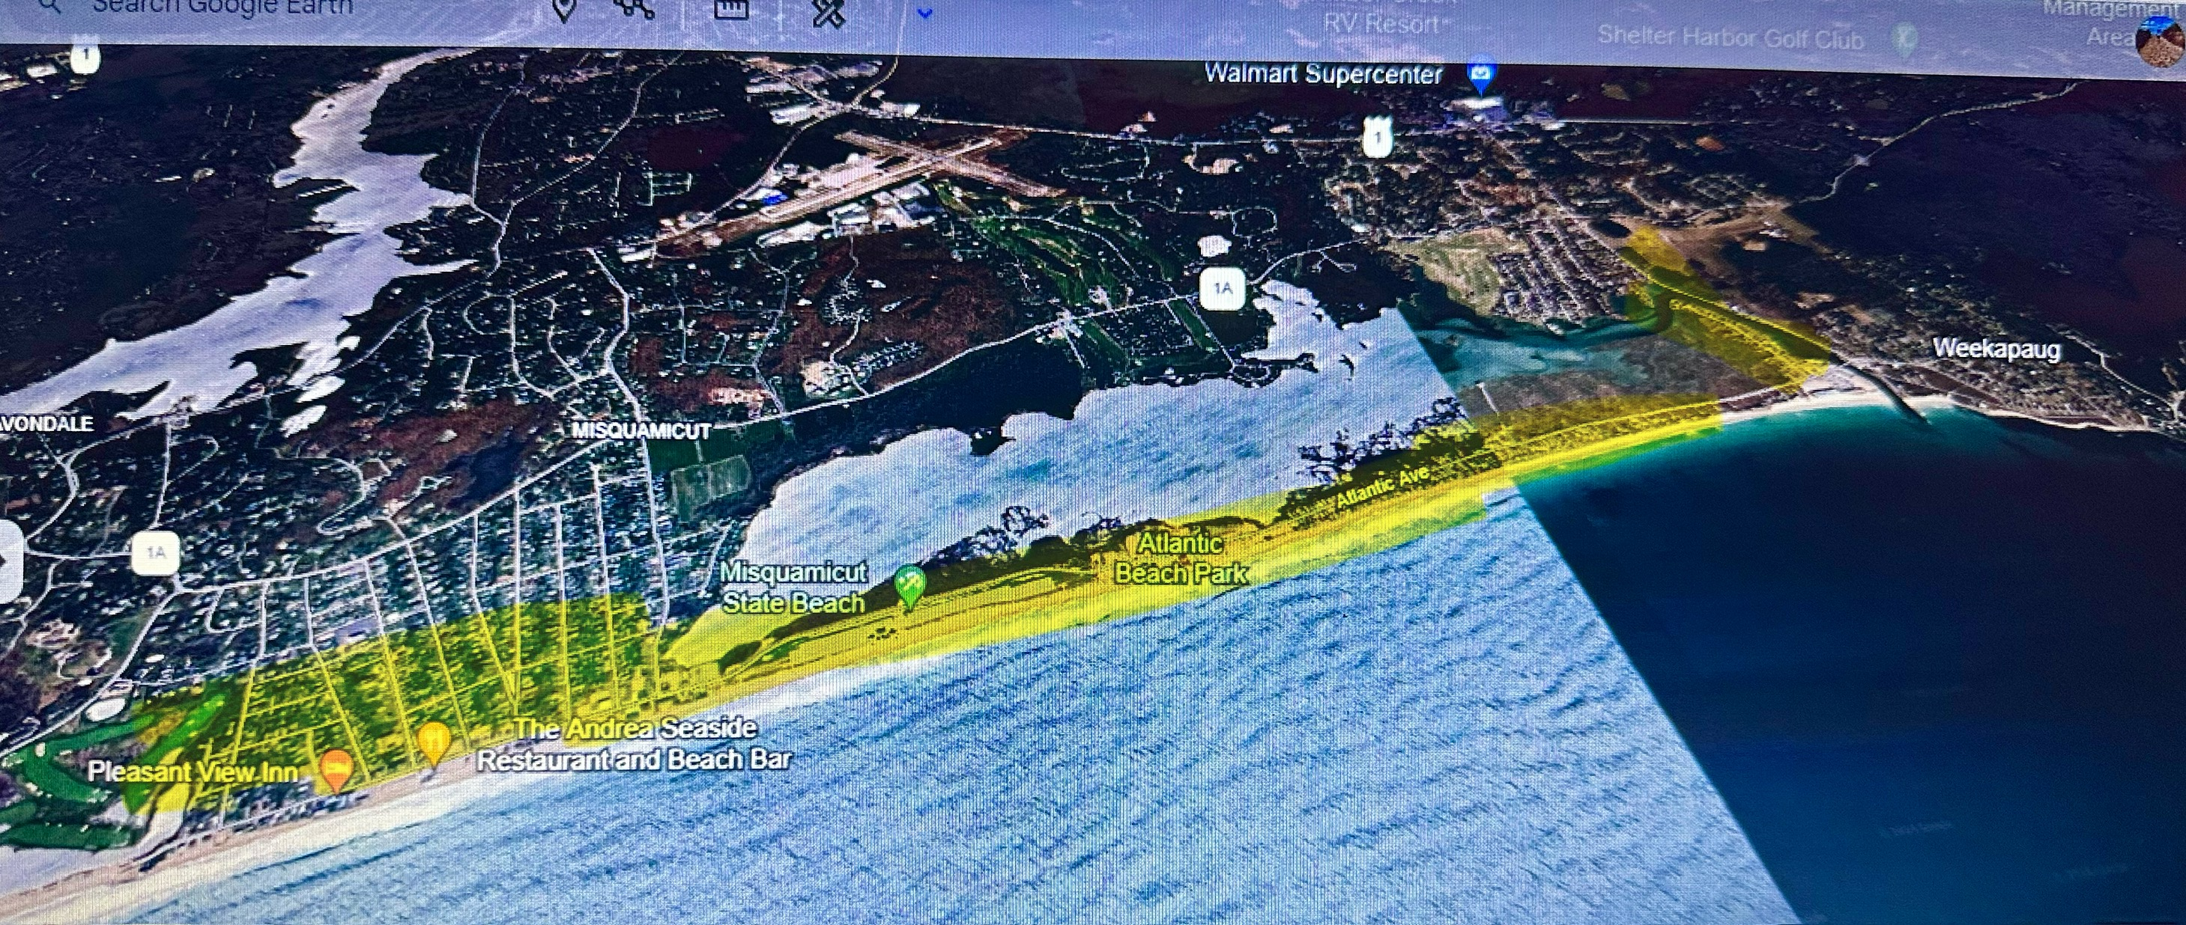

Slide 19
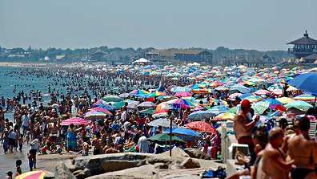
Does anyone really care if the beach goes away?

Slide 20
No parking means NO

Slide 21
SOLUTIONS

Slide 22
NOAA-National Oceanic and Atmospheric Administration
National Beach Nourishment Database
This database features information on nearly 400 projects that have placed nearly 1.5 billion cubic yards of sand along the continental U.S. coastline. The database includes the number of nourishment events, oldest project, newest project, known total cost, total volume, and known length.
https://coast.noaa.gov/digitalcoast/tools/beach-nourishment.html
Projects in Long Island, Outer Banks, Virginia Beach, Florida, Alabama and many more

Slide 24
Offshore Dredging
These projects are designed to manage the risk of coastal storm damage along the Coast in a way that balances risks to human life and property, while maintaining, enhancing, and restoring ecosystem integrity and coastal biodiversity.

Slide 25
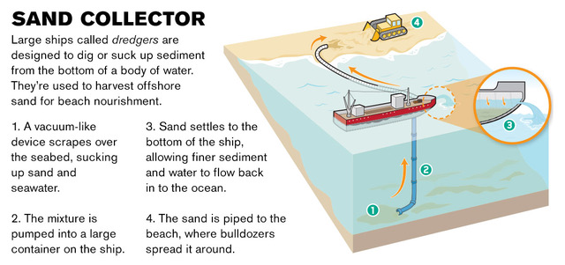
How Offshore Dredge Works
A solution for Misquamicut

Slide 26
Why Beach Nourishment?
Beach erosion is expected to become increasingly more detrimental in the coming years. While the construction of hard structures like seawalls and artificial reefs might last longer, "soft engineering projects" like nourishment and dune restoration are generally more sustainable and less intrusive. It needs to be repeated every 7-10 years.

Slide 27
Benefits & PUBLIC ACCESS
If we add 100-150 feet of beach, not only do we protect the infrastructure, revenue and jobs, but we expand public access. Right now, we all fight over a small bit of sand even with the 10-foot rule. If this project adds more beach, it is all public and cannot be off limits to anyone.

Slide 28
Insurance
Adding beach and protection for structures will bring down insurance rates and make it easier to obtain.

Slide 29
Weekapaug Breachway to Little Maschaug Pond 3 miles

Slide 30
Potential Costs
8-10 million dollars per mile (3 miles to do)
24-30 Million for the project each decade
Army Corp (Federal Government) pays 2/3
Balance of 8-10 Million
State owns a ½ mile of the 3 miles (4-5 Million)
Westerly would need to contribute 3-5 Million per decade for this project ($300-$500k Per Year)
Meal Tax-Hotel Tax-Fire District contribution are all possible ways as well

Slide 31
Perspective in spending for town of westerly budget
$100 Million annual Town Budget
$50 Million for Elementary schools
$13 Million for Police Station
$3.5 Million for School Street Roadwork
$3.5 Million for Public Works Facility
$300-$500 annually for keeping the ocean from taking Atlantic Ave. and losing 215 homes and dozens of businesses.

Slide 32
Perspective for the state
5 million contribution per decade to save over 150 million in direct revenue to the state budget.

Slide 33
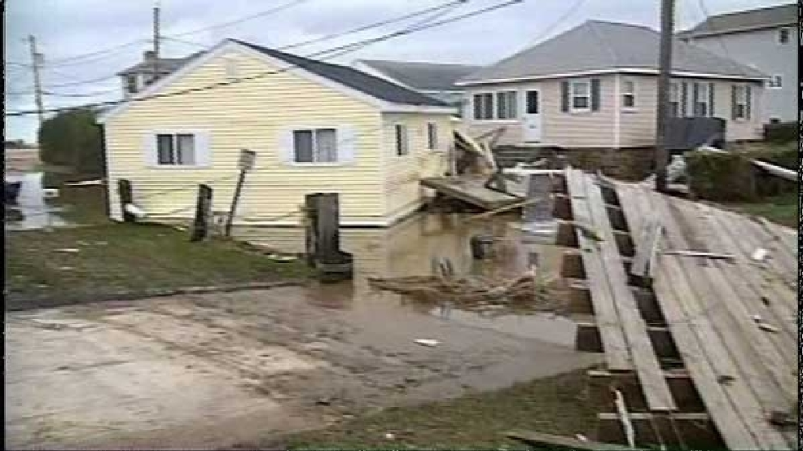
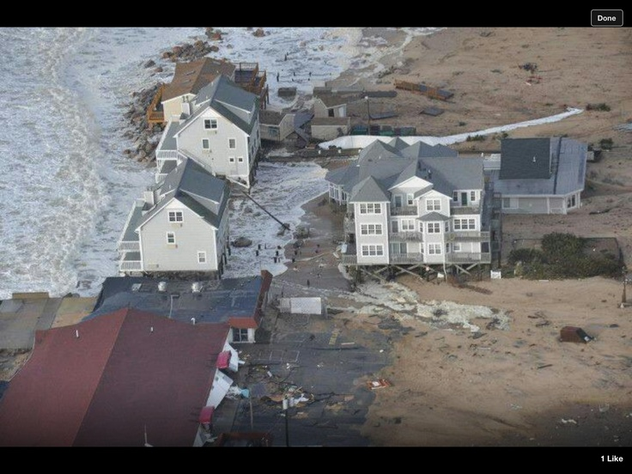
No Action Means
9 Million annual in Property taxes from Misquamicut lost and passed on to the rest of Westerly Taxpayers.
Spend 25-30 million per decade to save hundreds of millions
Or Spend hundreds of millions to remove all structures, septic, electrical, roads, water lines and other infrastructure. And lose access.

Slide 34
FINAL TIPS & TAKEAWAYS
Inaction will cost millions more than taking action
Long term benefits include greater public access, protection of assets, infrastructure, town and state property, homes and jobs
The clock is ticking, there is not much more time to act
This takes participation of many stakeholders all rowing in the same direction
Town Council
State Rep and Senator
Governors office DEM and CRMC
Fire District
Businesses
Home Owners

Slide 35
THANK YOU
Caswell Cooke
Executive Director, MBA
misquamicut2000@gmail.com

