Slide 1
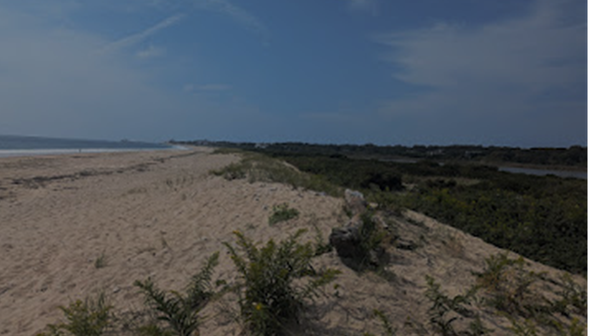
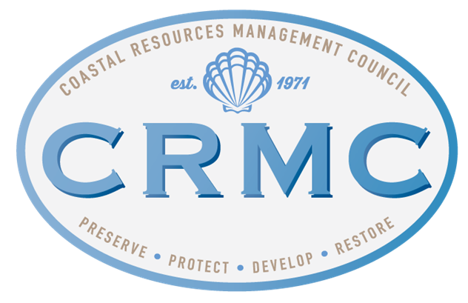
Presentation to the Special Commission To Make A Comprehensive Study And Provide Recommendations For Remedies To The Erosion Of Rhode Island Beaches Shoreline Change Special Area Management Plan: Managing Erosion
RI Coastal Resources Management Council
Jeffrey Willis, Executive Director
Emily Hall, Coastal Geologist

Slide 2
Outline
Shoreline Change Special
Area Management Plan
SAMP Overview
Rhode Island’s coastal hazards
Flooding
Erosion
Available planning tools
Stormtools & CERI
Erosion rates
Coastal Hazards Application
Adaptation strategies

Slide 3
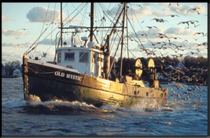
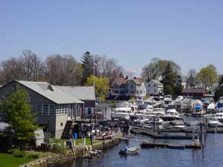
CRMC’s legislative charge: "...to preserve, protect, develop, and where possible, restore the coastal resources of the state for this and succeeding generations...”

Slide 4
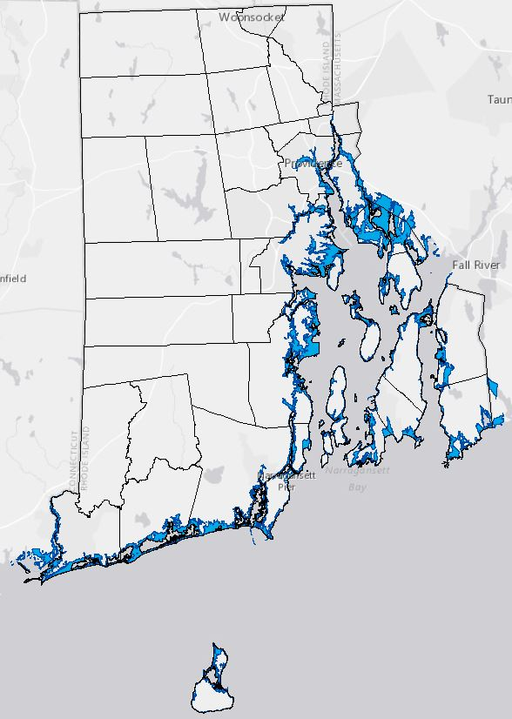
Shoreline Change SAMP Planning Boundary
7-feet of
sea level rise
+
100-year return period storm
(similar to 1954 Hurricane Carol)

Slide 5
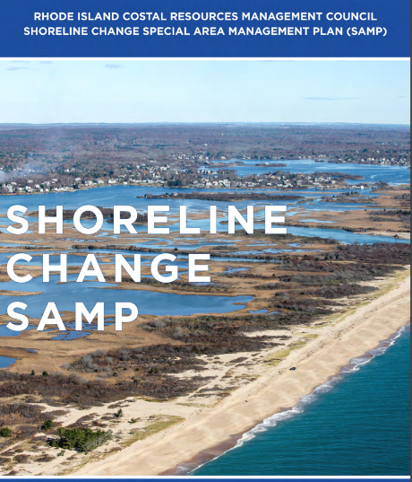
Chapter 1 – Introduction
Chapter 2 - Trends & Status: Current and Future Impacts of Coastal Hazards in RI
Chapter 3 – Assessing Coastal Hazard Risk
Chapter 4 – RI’s Exposure to Coastal Hazards
Chapter 5 - RI CRMC Coastal Hazard Application Guidance
Chapter 6 – State and Municipal Considerations
Chapter 7 - Adaptation Strategies and Techniques for Coastal Properties

Slide 6
Beach SAMP Chapter 4: Rhode Island’s Exposure to Coastal Hazards
4.1 Chapter Highlights
4.2 Introduction
4.3 Natural Environment
4.3.1 Beaches, Barriers and Headlands
4.3.1.1 Overview
4.3.1.2 Geologic Setting of the RI South Shore
4.3.1.3 Geologic Setting of Narragansett Bay
4.3.1.4 Physical Processes
4.3.1.5 Shoreline Protection Structures
4.3.2 Coastal Wetlands
4.3.2.1 Overview
4.3.2.2 The Effects of Sea Level Rise and Other Coastal Hazards on Coastal Wetlands
4.3.2.3 South County and Block Island
4.3.2.4 Narragansett Bay
4.3.3 Other Coastal Habitats
4.4 Effects of Erosion on Rhode Island’s Coast
4.4.1 Historic Shoreline Change
4.4.2 Projected Shoreline Change
4.5 Built Environment
4.5.1 CRMC Exposure Assessment
4.5.1.1 Exposed Residential Structures
4.5.1.2 Exposed Commercial Structures
4.5.1.3 Exposed Public Service Structures
4.5.2 Other State Assessments
4.5.2.1 Demographics
4.5.2.2 Critical Infrastructure
4.5.2.3 Wastewater Treatment Facilities
4.5.2.4 Drinking Water Utilities
4.5.2.5 Transportation Infrastructure
4.5.2.6 Public Access and Recreation Assets
4.5.2.7 Historic and Archaeological Assets
4.6 Synthesis: Exposure of Rhode Island’s Coastal Region to Storm Surge, Coastal Erosion
and Sea Level Rise
4.6.1 At‐Risk Areas
4.6.2 Storm surge, coastal erosion and sea level rise in RI
4.6.2.1 Matunuck Headland
4.6.2.2 Misquamicut
4.6.2.3 Barrington, Warren and Bristol
4.7 Synergistic Effects of Storm Surge, Coastal Erosion and Sea Level Rise

Slide 7
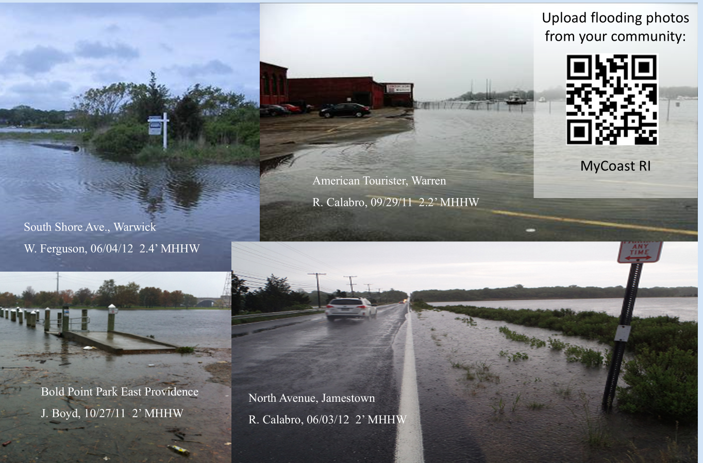
Hazards: Flooding
Nuisance floods (or “high tide floods”) are already occurring in numerous low‐lying locations around the state

Slide 8
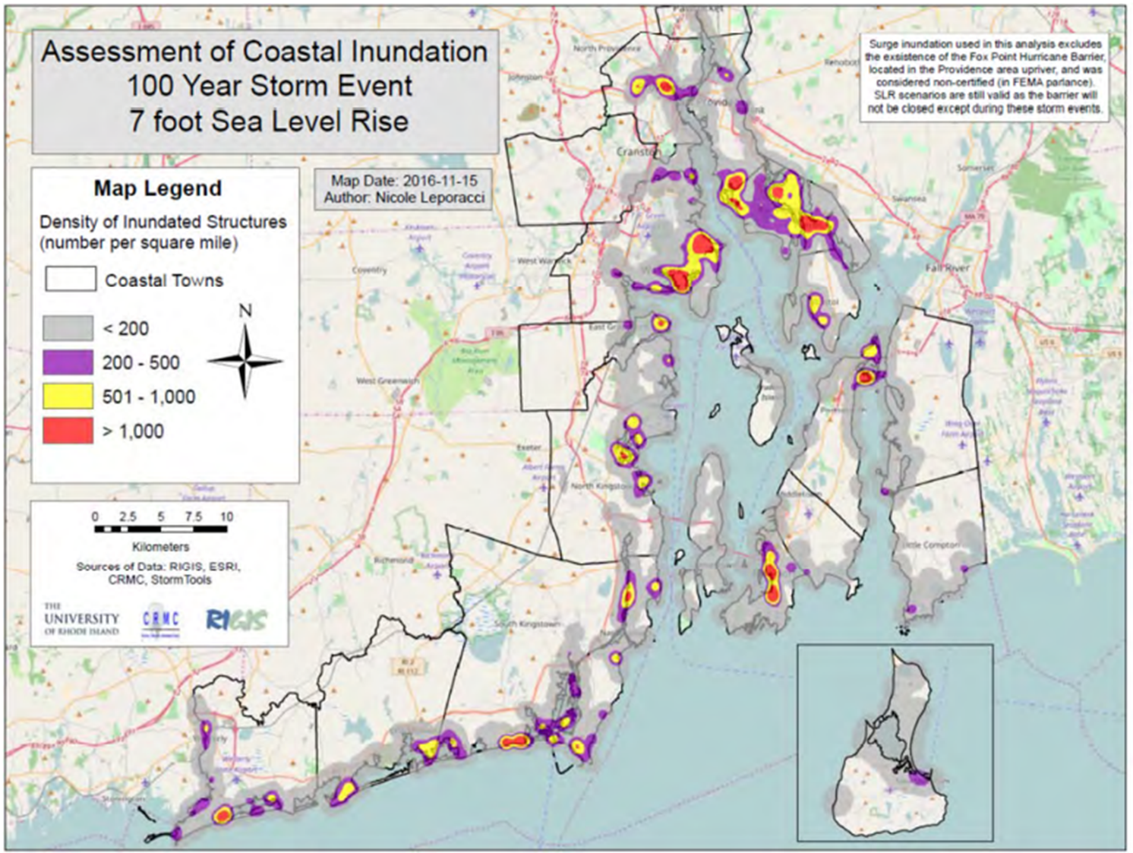
Hazards: Flooding
Coastal communities, including individual residential properties as well as commercial and industrial properties, are highly exposed to storm surges.

Slide 9
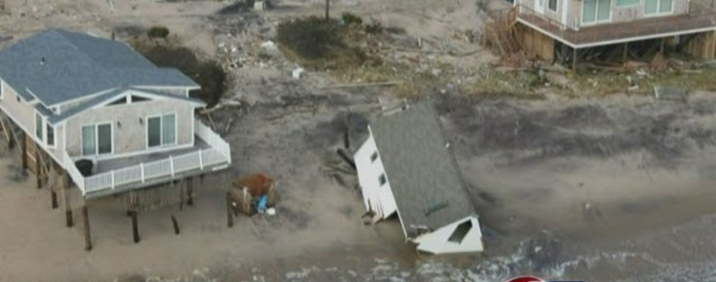
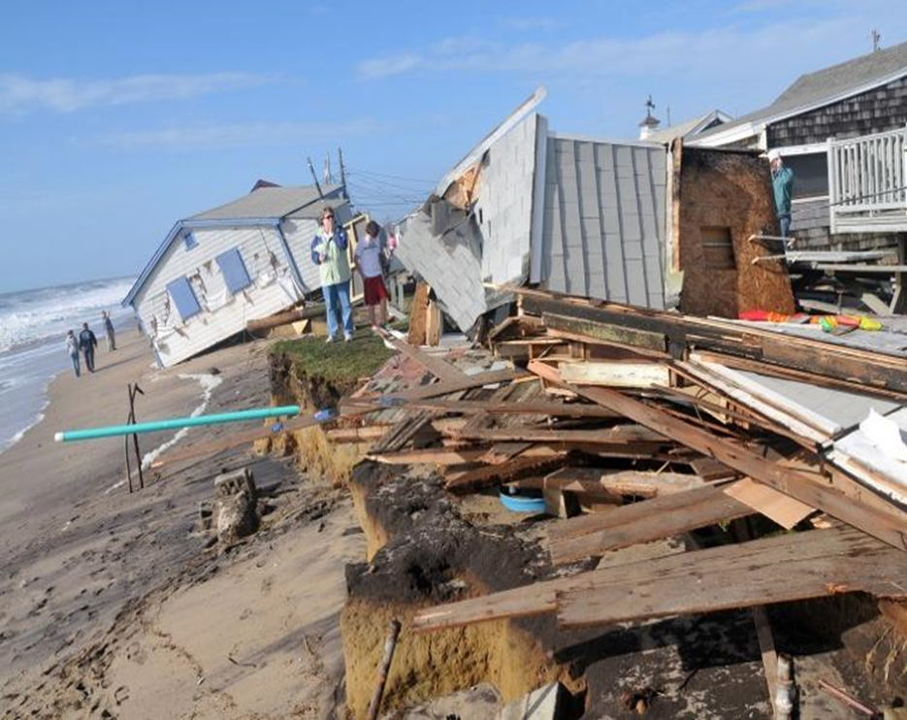
Hazards: Erosion
RI Shoreline is “sediment starved”
Predominantly storm based
Erosion exacerbated by hard coastal infrastructure
PTS Sandy

Slide 10
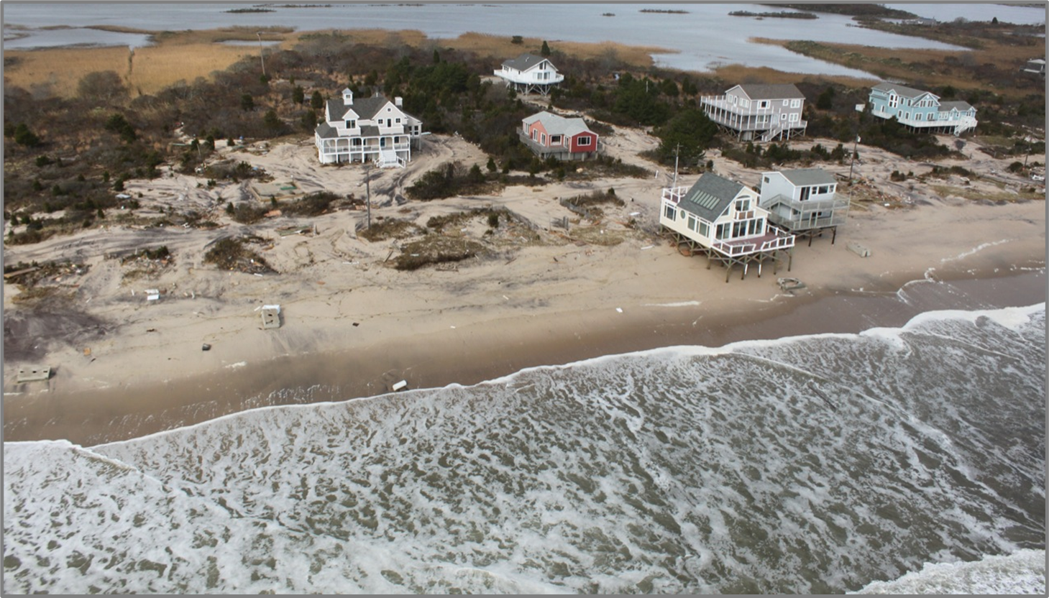
Where does the sand go?

Slide 11
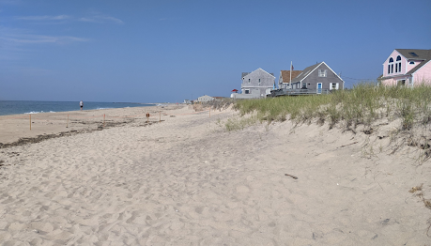
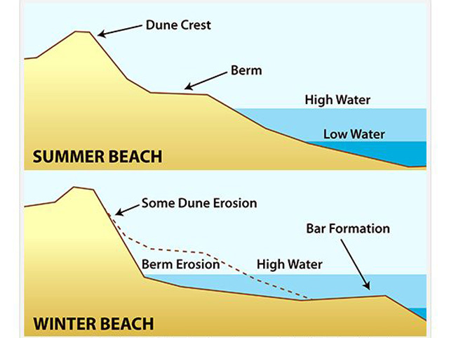
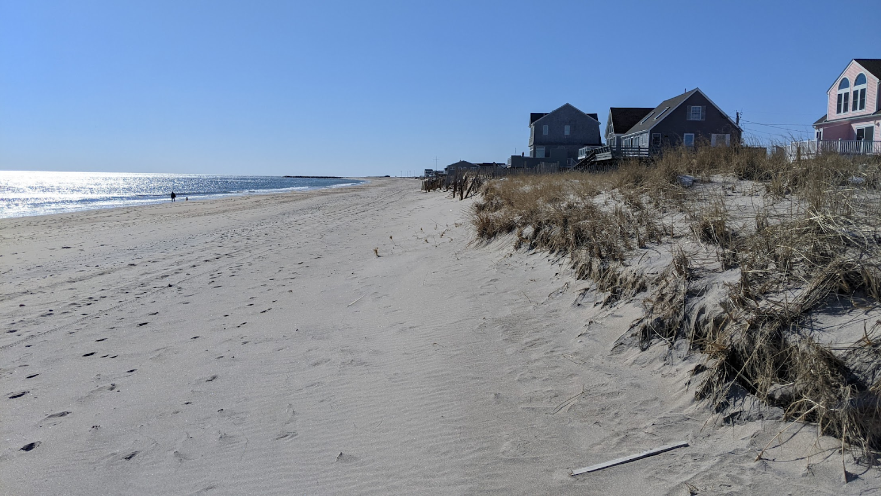
Wave Dominated & Sediment Starved

Slide 12
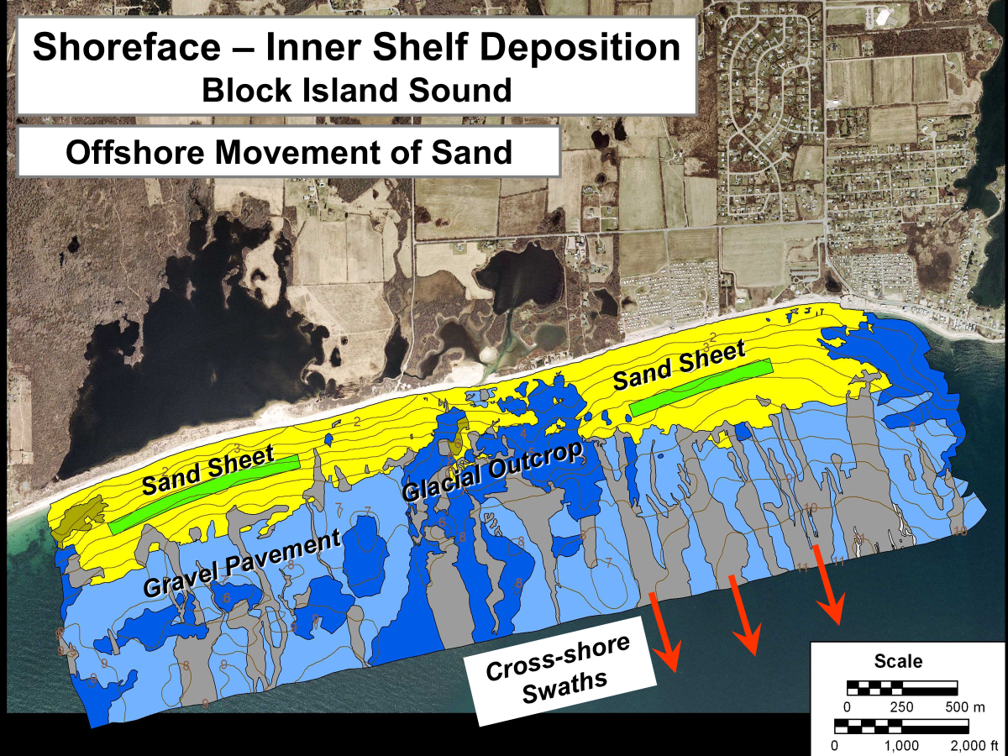
Oakley 2019

Slide 13
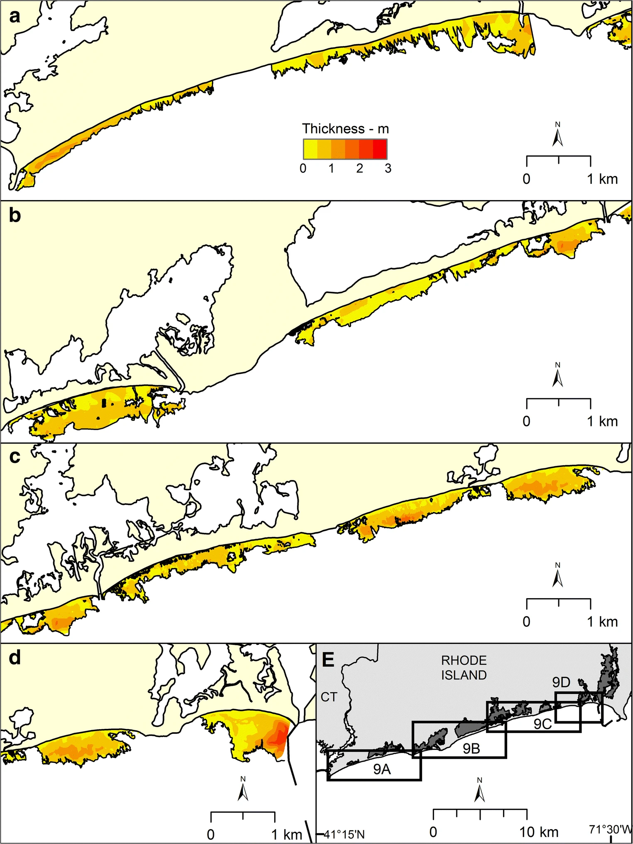
Offshore sand sheets
Location | Mean thickness (m) | Maximum thickness (m) | Extent (km²) | Volume (m³) | Volume uncertainty (± m³)
East Matunuck Barrier | 0.9 | 2.8 | 0.69 | 509,000 | 172,500
Matunuck Headland | 0.7 | 1.5 | 0.6 | 381,000 | 150,000
Moonstone Barrier | 0.7 | 2 | 0.62 | 375,000 | 155,000
Charlestown/Green Hill Barrier | 0.6 | 1.3 | 0.67 | 337,000 | 167,500
East Beach Barrier | 0.6 | 1.7 | 1.08 | 553,000 | 270,000
Quonnie Barrier | 0.6 | 1.4 | 0.95 | 562,000 | 237,500
Misquamicut Barrier | 0.6 | 1.7 | 0.91 | 472,000 | 227,500
Misquamicut Headland* | Insufficient | Data | 0.15 | 96,000* | 37,500
Maschaug Barrier | 0.6 | 1.5 | 0.15 | 63,000 | 37,500
Watch Hill Headland | 1 | 1.7 | 0.33 | 260,000 | 82,500
Total | 0.7 | 1.7 | 6.15 | 3,512,000 | 1,537,500
Oakley, et al., 2019

Slide 14
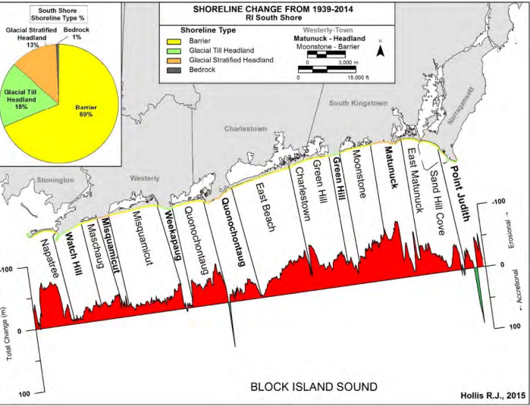
Coast is 95% Erosional Headlands average at 2.46 ft./yr Barriers at 1.87 ft./yr

Slide 15
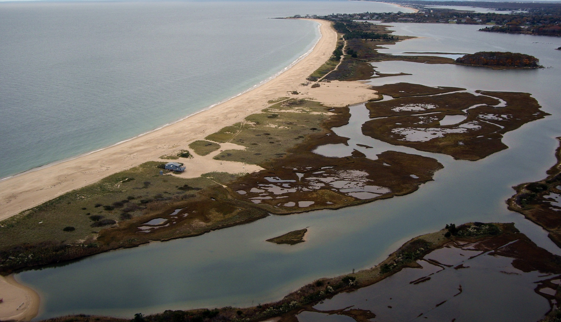
Erosion and Barrier Migration
Washover Fan Deposition
Pre-Sandy
Bousquet and Son – Aerial Views

Slide 16
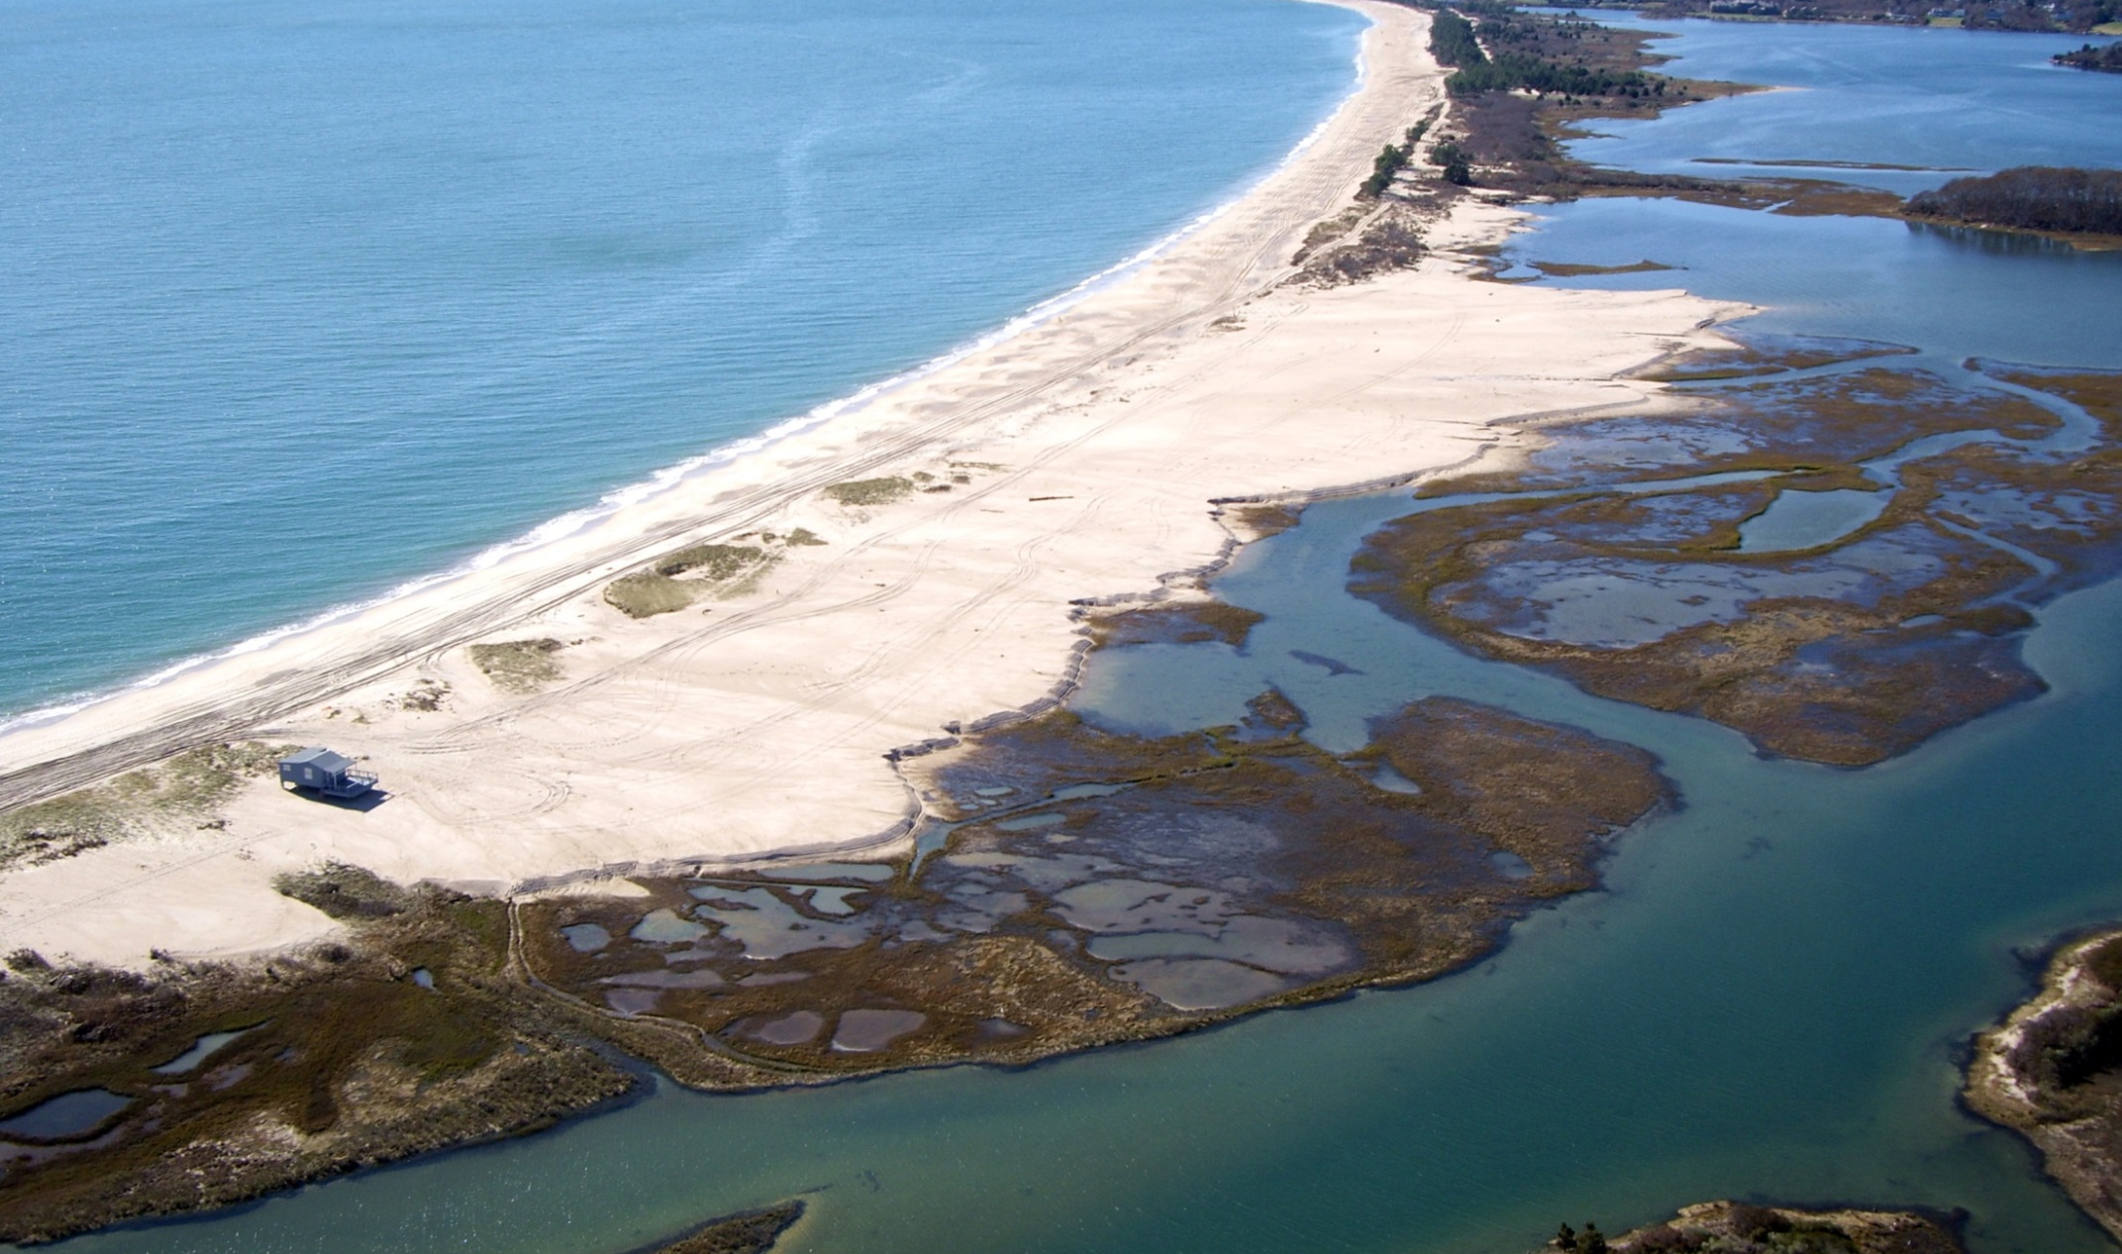
Erosion and Barrier Migration
Washover Fan Deposition
Post-Sandy
Bousquet and Son – Aerial Views

Slide 17
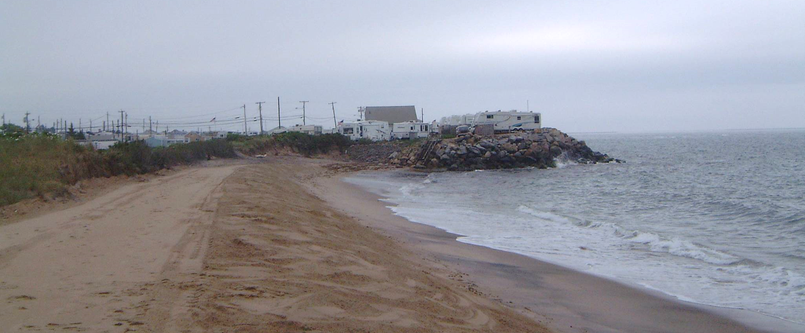
Erosion and Hardened Shorelines
Surfrider, 2021

Slide 18
Planning tools: STORMTOOLS
What will inundation look like in a future storm as sea levels rise?
STORMTOOLS is a method to illustrate and display storm inundation, with and without sea level rise, for different types of storms that could occur along Rhode Island's coastline.

Slide 19
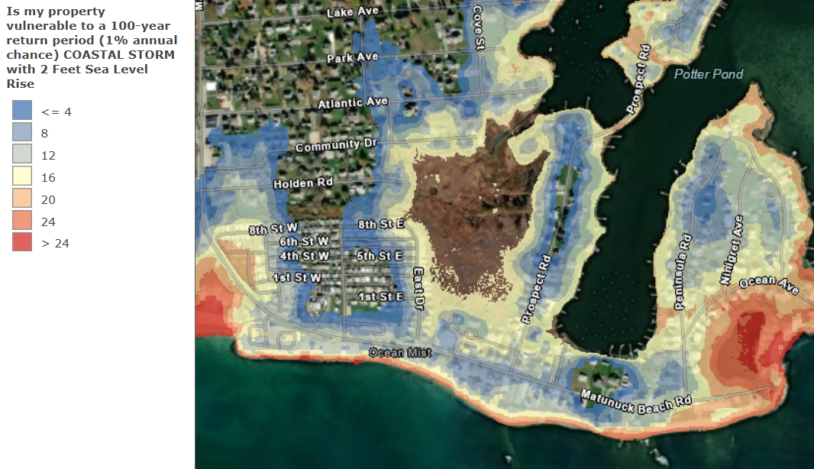
Planning tools: STORMTOOLS
Predictions (95% confidence) show water extent and depth for:
Nuisance floods (1, 3, 5, and 10 year recurrence intervals)
Storm Scenarios of 25, 50, 100, and 500 years
Sea Level Rise Scenarios of 1, 2, 3, 5, and 7 feet
Sea Level Rise Scenarios combined with each Storm Scenario

Slide 20
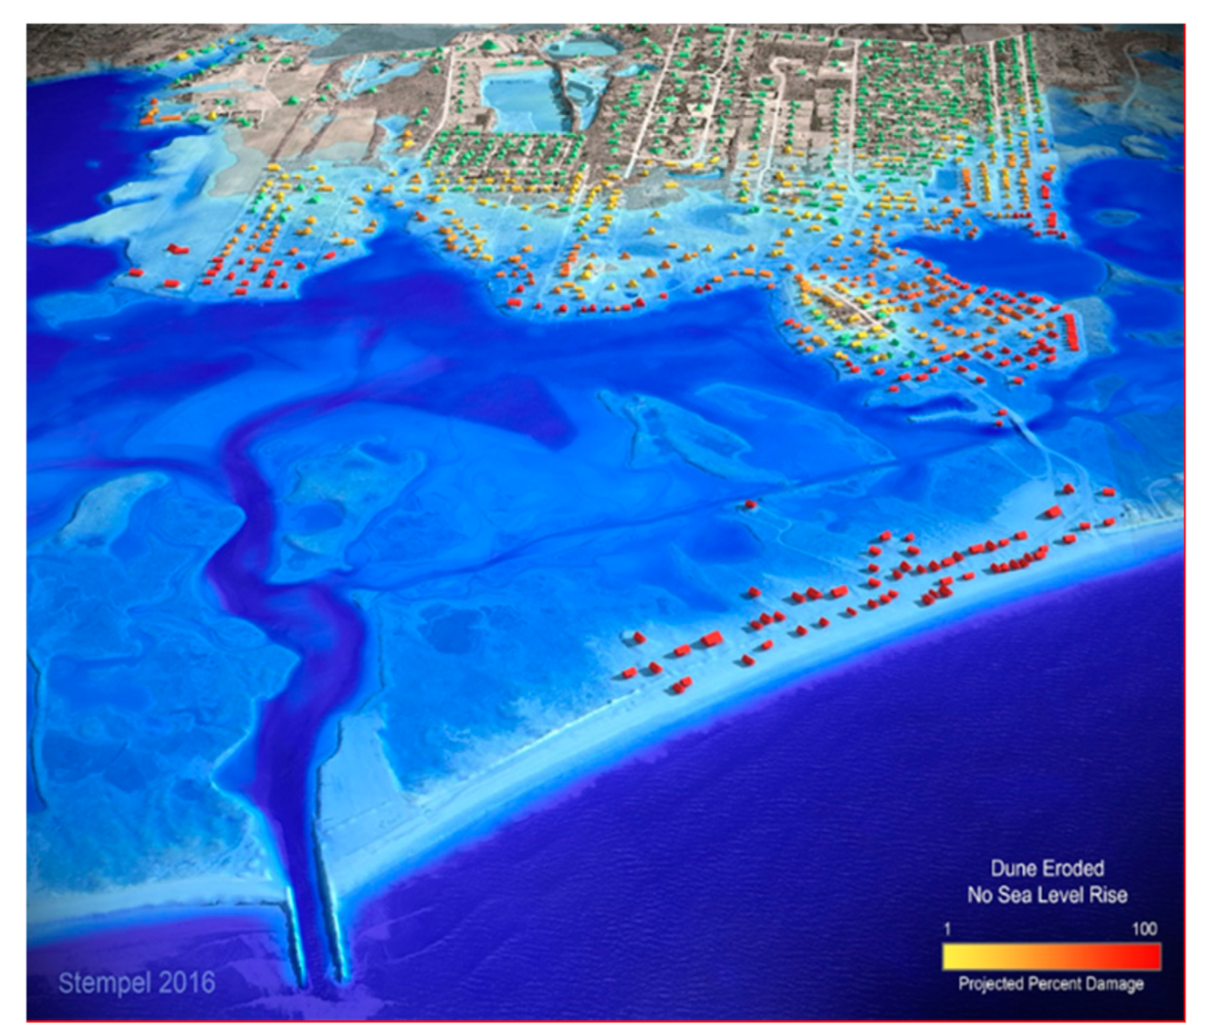
Planning Tools: Coastal Environmental Risk Index
How much structural damage is expected from a future storm?
Combines storm and sea level rise predictions from Storm Tools with a damage index for different structure types
Charlestown
100 Year Storm
No Sea Level Rise

Slide 21
Planning Tools: CERI
75-100%
Residential Structures’ Categories:
1 story, no basement
2+ Story, no basement
1 story with basement
2+ story with basement
Elevated on open piles
Elevated on closed piles
50-75%
25-50%
0-25%
0
Notes:
21

Slide 22
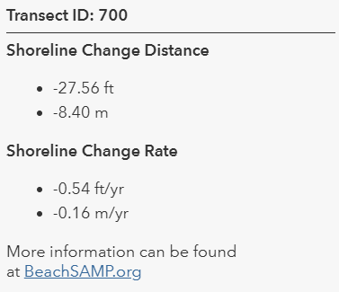
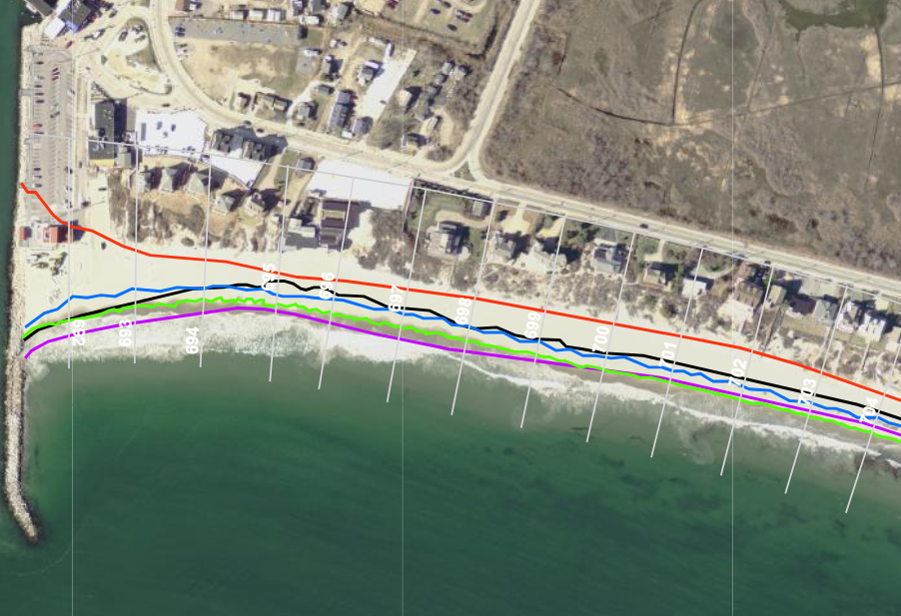
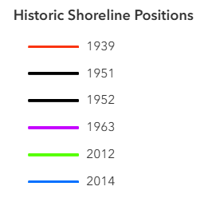
Planning Tools: Erosion Rates
How much has the shore eroded in the last hundred years?
Shoreline position digitized from aerial imagery from 1939-2014
Rates of change derived from shoreline positions

Slide 23
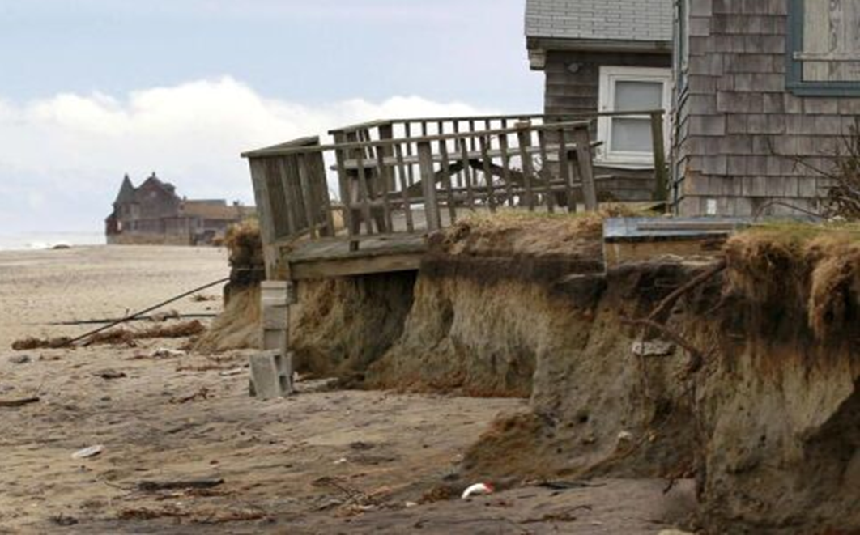
Planning Tools: Coastal Hazard Application
What level of risk is assumed over the design life of a new structure?
Incorporates:
Expected tidal inundation from sea level rise
Impacts to structure as well as access roads
Projected erosion rates
CERI structural damage risk estimates

Slide 24
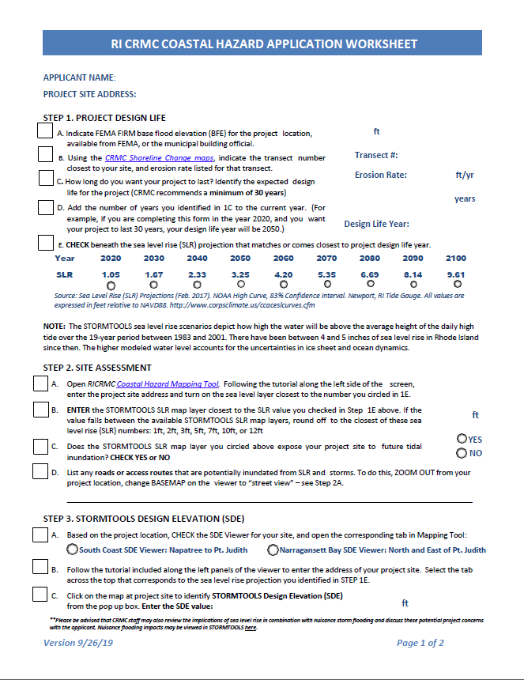
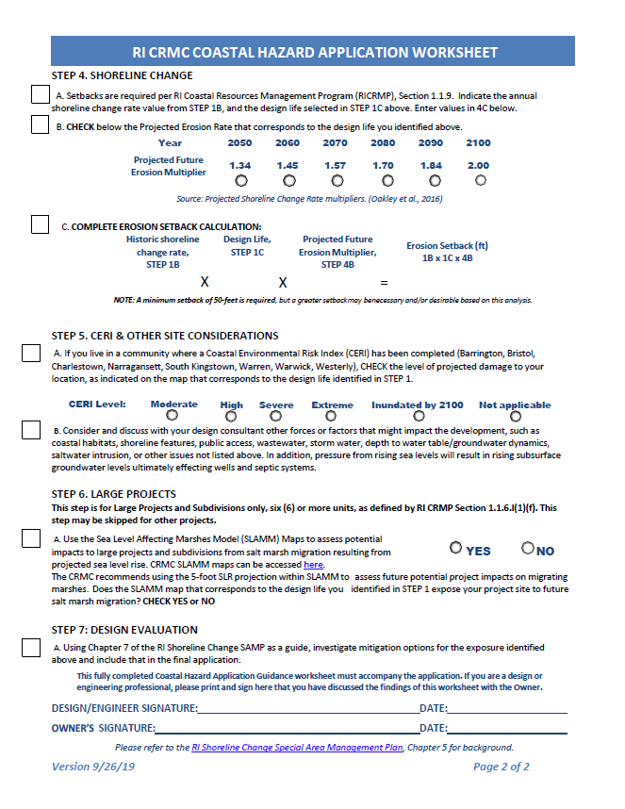

Slide 25
Adaptation measures: Protection, Accommodation, Retreat
Site Selection
Distance inland
Elevation
Terrain management
Natural or nature-based measures
Flood barriers
Structural shoreline protection
Floodproofing
Relocation and Managed Retreat

Slide 26
Structural Shoreline Protection
“Like flood barriers, CRMC staff have found that structural shoreline protection measures are often either undersized or under‐designed for the sources of coastal hazard risk they are intended to address….Structural shoreline protection measures can have a broad range of negative impacts on adjacent beaches and properties, on the natural environment, and on shoreline public access. Further, they are insufficient adaptation measures to respond to the latest sea level rise projections”

Slide 27
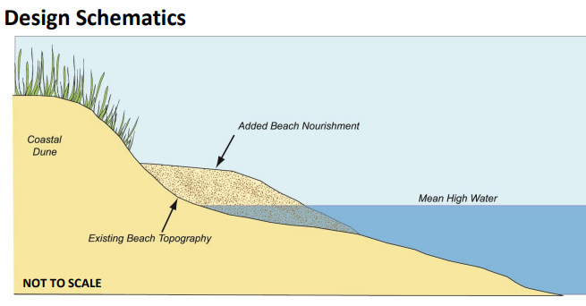
Nature Based Measures
Living shorelines
Natural dunes
Dunes with engineered cores
Beach nourishment
Natural coastal bank
Coastal bank with engineered cores
Marsh creation
Living breakwaters

Slide 28
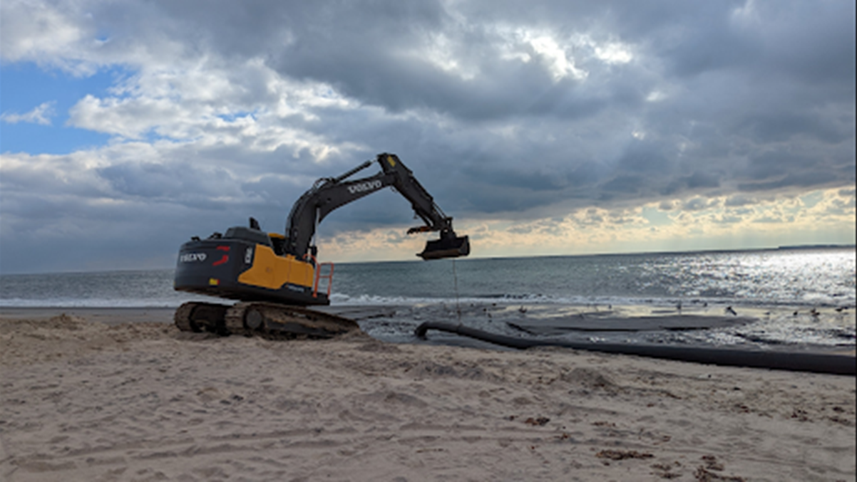
Beach Nourishment
Already happening at municipal level – Charlestown, Narragansett

Slide 29
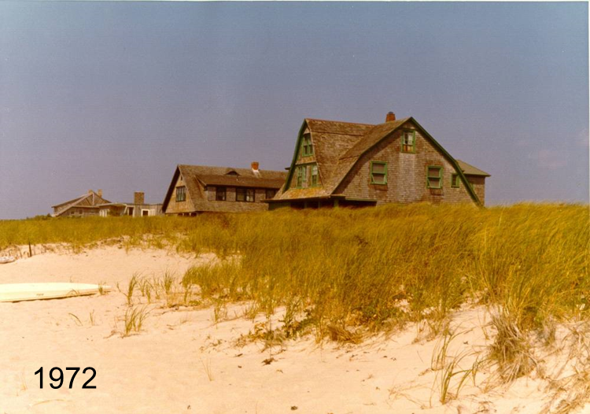
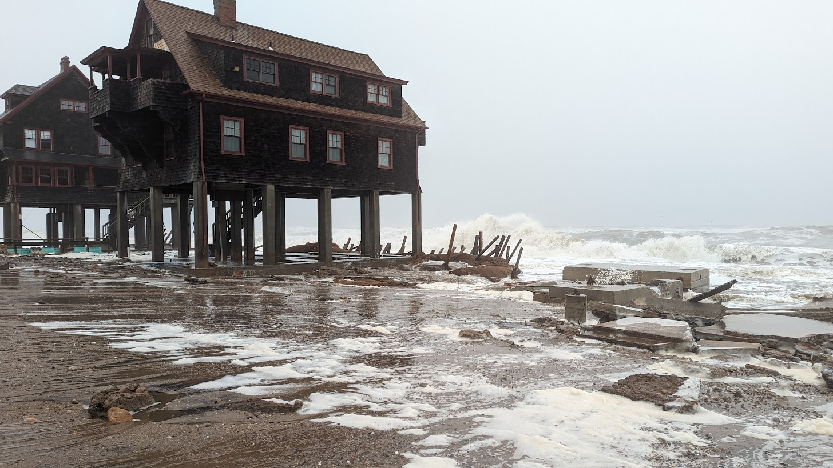
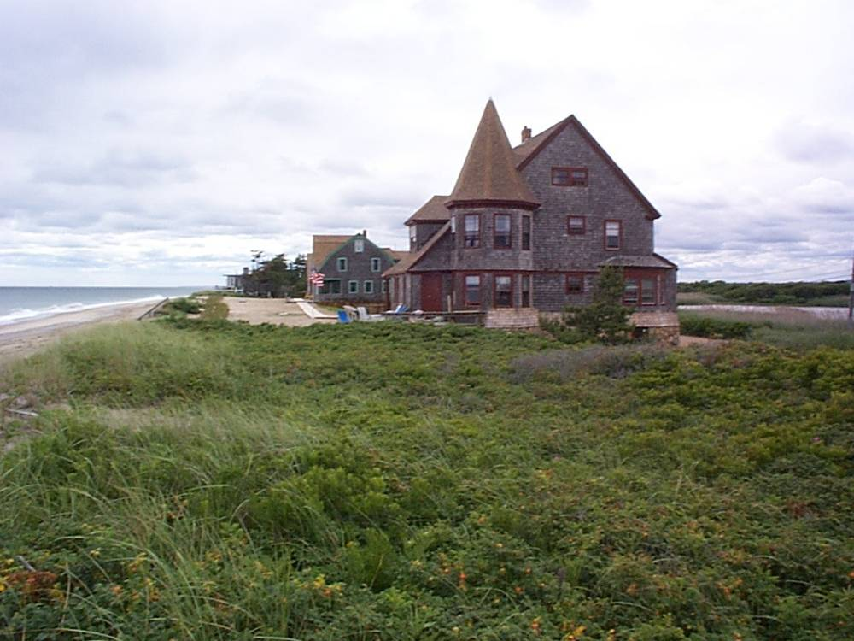
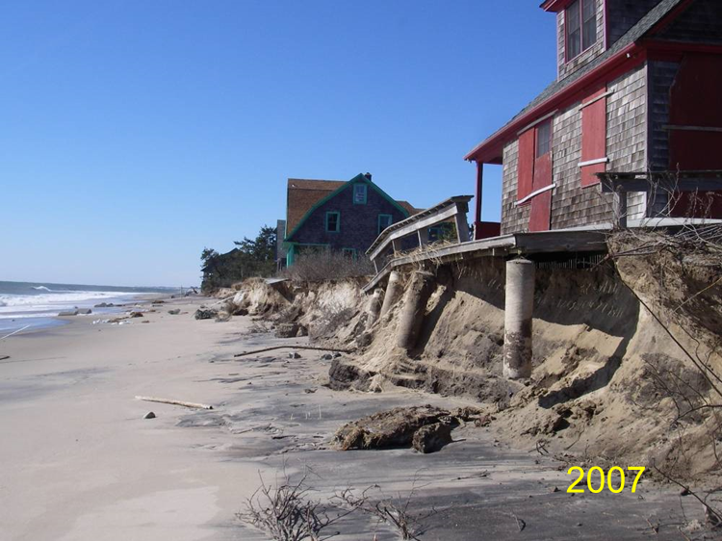
Managed Retreat
Moving inland at the site or parcel level
For new builds, building in a way that makes relocation easier
Relocation of structures to entirely new parcels
Abandoning properties completely
This is already happening at the site level across Rhode Island.
December 2023
1972
1999 – 50 ft relocation

Slide 30
Moving Forward
Mitigation of future hazards via informed development of coastal areas
STORMTOOLS, CERI, CHA
Adapting existing development to longer planning horizons
Proactive planning, Nature based solutions, continued maintenance

