Slide 1

November 19, 2024
Presentation to the
SPECIAL COMMISSION TO MAKE A COMPREHENSIVE STUDY AND PROVIDE RECOMMENDATIONS FOR REMEDIES TO THE EROSION OF RHODE ISLAND BEACHES
&
LEGISLATIVE STUDY COMMISSION ON CLIMATE CHANGE IMPACTS AND SOLUTIONS
Meredith E. Brady, Associate Director
DOA, Division of Statewide Planning

Slide 2
A Plan Without Data is a Guess
The Role of Statewide Planning in Rhode Island

Slide 3
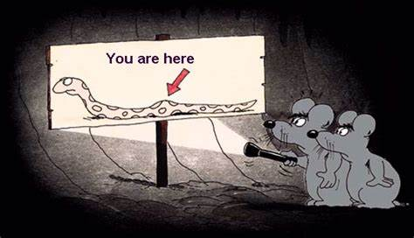


Slide 4
Division of Statewide Planning Mission Statement
  The Division of Statewide Planning promotes and encourages
  best practices for the balanced growth and development of the
  State of Rhode Island. We do so by:
    • Connecting agencies, communities, and organizations;
    • Guiding land use, water, and transportation choices; and
    • Promoting continuous, cooperative, and comprehensive
    application of planning principles, along with data-driven
    analysis, to create and implement State, regional, and
    local plans.
  Our goal is to ensure equitable, sustainable, and resilient
  development that meets the needs of the present without
  compromising the needs of the future.

Slide 5
State Planning Council
Transportation Advisory Committee Technical Committee
RIGIS Executive Committee Freight Advisory Committee
Advisory Committee on Education Ad Hoc Committees
Congestion Management Task Force
Water Resources Board
Property Committee
Drought Advisory Committee
Ad Hoc Committees
Meredith E. Brady
Associate Director
Transportation Planning Team
Mason Perrone, Assistant Chief
Liza Farr, Supervising Planner
Benny Bergantino, Principal Planner
Bobby Echevarria, Principal Planner
Asher Eskind, Principal Planner
Land Use, Process, & Education Team
Nancy Hess, Interdepartmental Project Manager
Paul Gonsalves, Supervising Planner
Isabelle Gillibrand, Principal Planner
Community Coordination Team
Roberta Groch, Assistant Chief
Josh O’Neill, Supervising Planner
Caitlin Greeley, Supervising Planner
Abbey Dahl, Principal Planner
Water Team
Kathleen Crawley, Acting General Manager
Patrick Killian, Data Analyst I
Hector Barreras, Programming Services Officer
David Procaccini, Programming Services Officer
Data Team
Data Group Administrative Group
Vincent Flood, Data Analyst II Paul Capotosto, Asst. Admin, Financial Management
Christina Delage Baza, Data Analyst I
Benjamin Jacobs, Principal Research Technician Lori Cassin, Chief Implementation Aide
Garth Hoxsie-Quinn, RIGIS Coordinator Maria Mignanelli, Chief Implementation Aide

Slide 6
Division of Statewide Planning Roles – Requirements
The Statewide Planning Program consists of the State Planning Council, and the Division of Statewide Planning, a division within the Department of Administration.
The State Planning Council (27 members) is comprised of federal, state, local, public representatives, and other advisors, and guides the work of the Program.
The Division of Statewide Planning is the staff agency of the State Planning Council. The objectives of the Program are to:
Establish and manage a fair and impartial setting for effective regional decision-making;
Develop transportation improvement options and use data and planning methods to evaluate whether those options support criteria and system performance targets. Planning studies and evaluations are included in the Unified Planning Work Program (UPWP);
Develop a Transportation Improvement Program (TIP);
Develop a Long-Range Transportation Plan (more on that later!);
Identify performance measure targets and monitor whether implemented projects are achieving targets;
Involve the general public and other affected constituencies;
Prepare Guide Plan Elements for the State;
Coordinate activities of the public and private sectors within the framework of the State Guide Plan;
Assist municipal governments with planning; and
Advise the Governor and others on physical, social, and economic planning related topics.

Slide 7
Move to the Foundry (accessibility)
Long Range Transportation Plan Limited Update
Complete Streets Guidebook
Newport Transportation Plan
Big River Management Area Property Mgmt. Plan
Social Equity Tool
State Freight Committee
East Providence Bike & Pedestrian Master Plan
Small Business Resilience
I-95 Corridor Coalition (The Eastern Transportation Coalition) Training and Involvement
TRB & NCHRP Involvement
Regional MPO Outreach and Coordination
STIP admin & 14 amendments FFY2022-FFY2031 STIP
Migration to an E-STIP and PMG STIP Manager Platform
Tri-Party Agreement & STIP MOU in Changing Times
Historic Preservation, Economic Development, Solid Waste Guide Plan elements; collaboration on Housing
Continuing Education of Decisionmakers and Committees
Training and Professional Development
FHWA Climate Change Webinars
Annual Obligation Report
Census Data and Census 2020 … Population Projections pending; Land Use 2050 data in development
Update of Public Participation Plan & LEP
Contact Database Development
Continuous Development of Map Data and Map Products
Local Partnerships
Revolving Terms Re-Established
State Planning Council Membership Changes
Pivot to Virtual Public Meetings due to COVID
Pivot Back to In-Person Post-COVID, with Hybrid Options

Slide 8
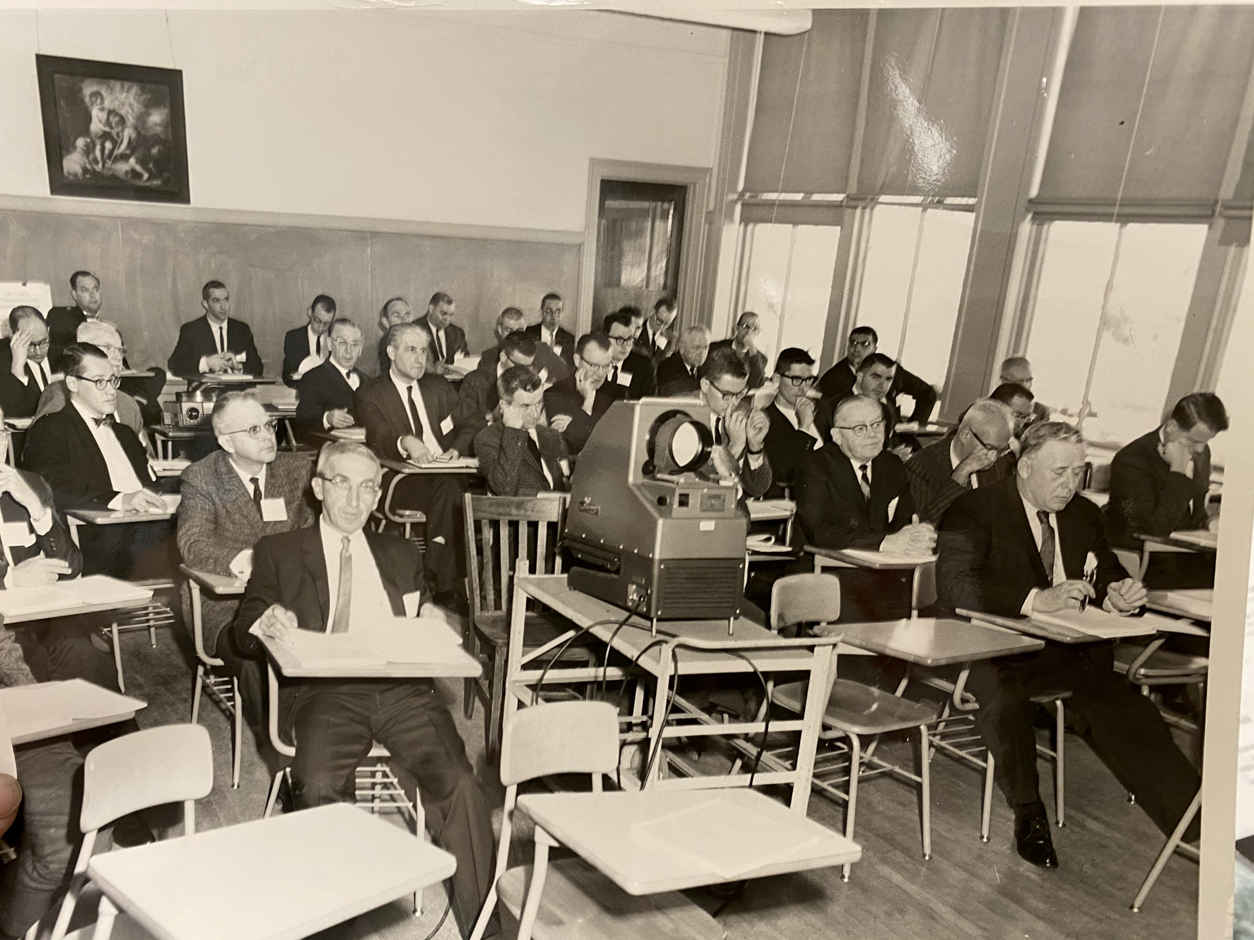
Some Basic Facts:
Name: Providence MPO/State Planning Council/Statewide Planning
Year Established: 1934/1964/1974
2020 Population: 1,097,379
Comparative Size: 50th largest of 411 MPOs
Largest MPO: Southern California Association of Governments (18,051,203)
Smallest MPO: West Memphis Area Transportation Study (42,214)
Connecticut has 9 MPOs; Massachusetts has 10 MPOs
Even Delaware and Hawaii have 2 MPOs
Vermont has a single MPO but multiple Regional Planning Agencies.

Slide 9
Fitting the Pieces Together
10,000 Foot View
A Closer Look
Measurable Steps
State Guide Plan Elements
Local Comprehensive Plans
Goals and Objectives
Long-Range Plans
Implementation Plans/Programs
Short Term Goals/Objectives

Slide 10


+
“Steak Guy Plan”

Slide 11
What is the State Guide Plan?
The State Guide Plan (SGP) is Rhode Island’s centralized and integrated long-range planning document.
It is not a single document but a collection of plans that have been adopted over many years.
It comprises separately published elements covering a range of topics.
Currently there are 18 elements.
RIGL 42-11-10(d) State guide plan. Components of strategic plans prepared and adopted in accordance with this section may be designated as elements of the state guide plan. The state guide plan shall be comprised of functional elements or plans dealing with land use; physical development and environmental concerns; economic development; housing production; energy supply, including the development of renewable energy resources in Rhode Island, and energy access, use, and conservation; human services; climate change and resiliency; and other factors necessary to accomplish the objective of this section. The state guide plan shall be a means for centralizing, integrating, and monitoring long-range goals, policies, plans, and implementation activities related thereto. State agencies concerned with specific subject areas, local governments, and the public shall participate in the state guide planning process, which shall be closely coordinated with the budgeting process.

Slide 12
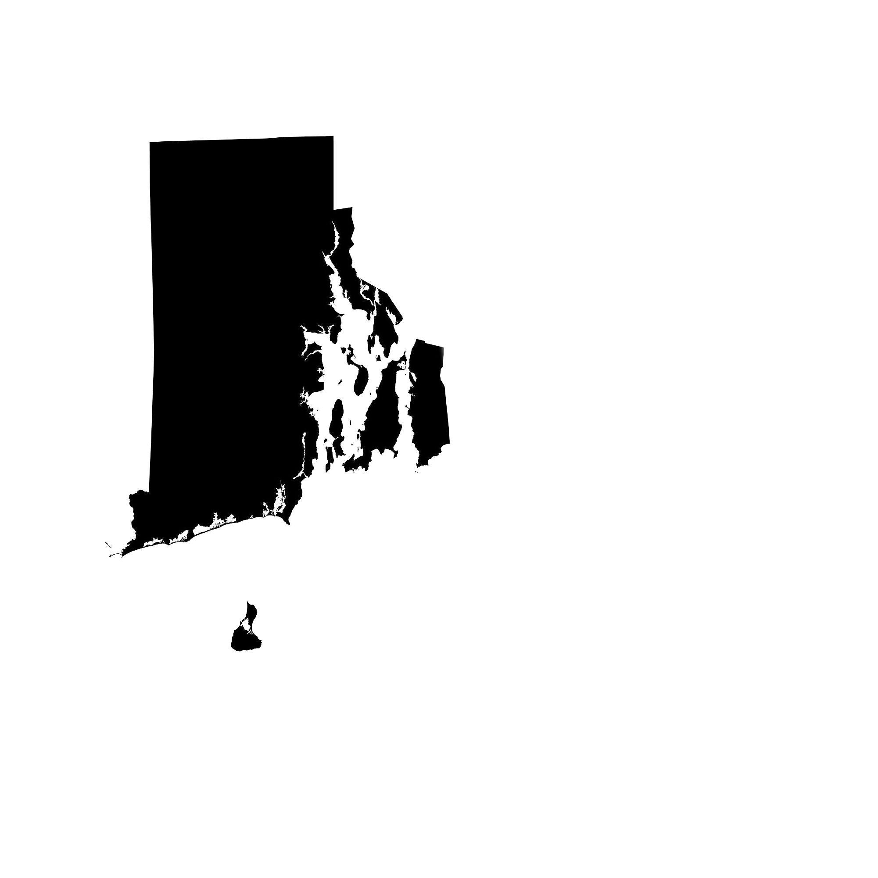
Transportation
Solid Waste
Management
Energy
Water Resources
Economic Development
Historical Preservation
and Cultural Heritage
Housing
Recreation &
Open Space
Land Use
Natural Resources
Equity
Climate Change & Resiliency

Slide 13

Rhode Island’s Reciprocal System of Comprehensive Planning
Rhode Island has a reciprocal system of land use planning: the State sets broad goals and policies through the State Guide Plan and municipalities express local desires and conditions through the Community Comprehensive Plan.
These local comprehensive plans serve as the basis for land use regulation and establish an implementation program for achieving each community’s stated goals.
The local comprehensive plans are reviewed by the State, and when approved, become binding on State agencies by requiring conformance of their programs and projects to the municipal comprehensive plan.

Slide 14
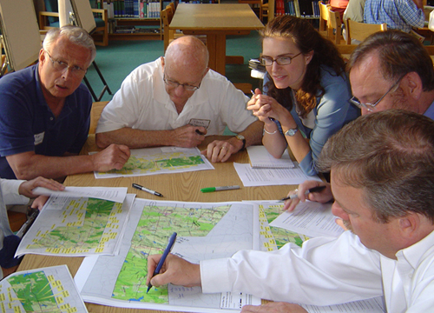
What is the Purpose and Importance of the Municipal Comprehensive Plan?
A Municipal Comprehensive Plan:
1) Has the legal authority to act as the vehicle for guiding community development
2) The scope to cover the necessary functions and processes to achieve community goals
4) The history of practice to inspire public acceptance of its policies.
3) Has the advantage of being able to coordinate other policies, plans, and programs into a single accessible document.

Slide 15


Are Communities Penalized If They Don’t Have An Approved Comp Plan or Exceed the 5 Year Reporting Deadline ?
Also, per RIGL 45-22.2-13 “(h) Upon approval by the chief or superior court, the municipality is eligible for all benefits and incentives conditioned on an approved comprehensive plan pursuant to this chapter, and the municipality is allowed to submit the approved comprehensive plan or relevant section thereof to any state agency which requires the submission of a plan as part of its requirements, and the plan or relevant section thereof shall satisfy that requirement.”
Although the required by law, there has been no specific penalty for failure to comply. Until March 1, 2024 when RIGL 45-22.2-12(b) took effect. “If a municipality fails to fully update and re-adopt its comprehensive plan within twelve (12) years from the date of the previous plan’s adoption, such municipality shall not be able to utilize the comprehensive plan as a basis for denial of a municipal land use decision.”

Slide 16

Why Do Municipalities Have to File a Status Report?
This requirement is meant to help, not hinder municipal planners
Keep Comprehensive Plans “Alive”
Track Implementation to see where communities have successes and where they struggle
Feedback will shape the types of technical assistance provided by Statewide Planning
Help focus local planning efforts and continue to maintain the importance of Comprehensive Plan consistency in all development reviews

Slide 17
This map shows the percent change in total population from the 2010 Census to the 2020 Census at the municipality level.
Top 5 in terms of population growth were New Shoreham, Central Falls, East Greenwich, Cumberland and Providence
Strong growth in northeast urban core cities
Narragansett, Foster and Bristol lost population.

Slide 18
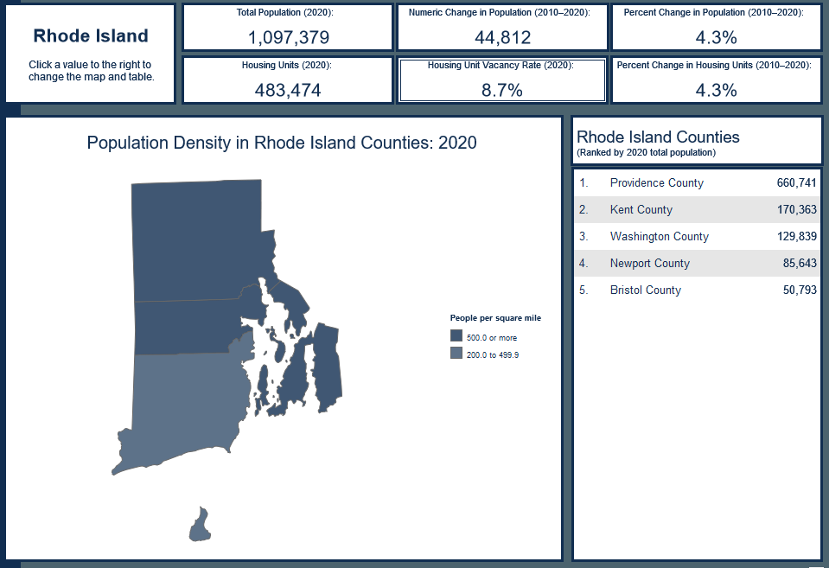
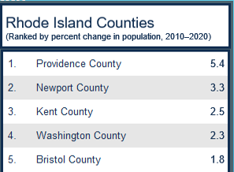
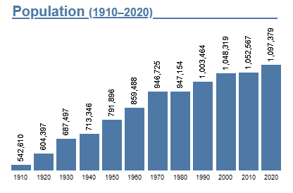
Rhode Island’s Population Grew 4.3% Last Decade

Slide 19
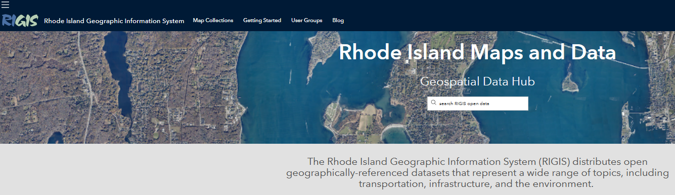
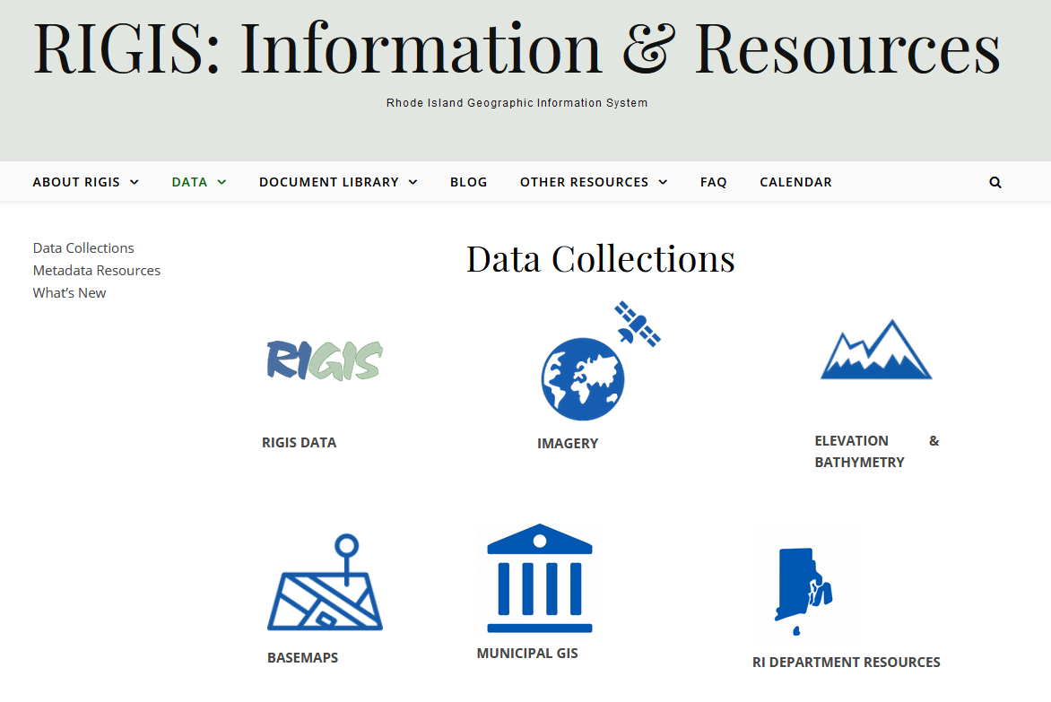
RIGIS Online Database
Other Data Resources
Free access and downloads
Several Hundred Spatial Datasets, Categories
Many Contributors
Managed by URI Geospatial Extension Specialists
Aerial Photography – RIDSP, RIDOT, RIDEM...
Notes:
Through the RIGIS Website…RIGIS is able to provide free access to, and downloads of, hundreds of spatial datasets across several thematic categories.
The database is compiled from data submissions by many contributors across the state, including state agencies.
These data adhere to the RIGIS quality assurance and federal metadata standards, and are maintained by the data source providers.
The RIGIS database and website is managed by the URI Geospatial Extension Specialists.

Slide 20


Background
Inspired by … federal Justice40 initiative + oodles of new equity data
Started as … update to RIDSP transportation equity analysis
Expanded to … State Working Group to internally align social equity data
Emerged as … a social equity data platform to gather multi-disciplinary data for use as “Step 0” in incorporating equity into planning and policies
Notes:
So we were inspired by this flood of oodles of new equity data in 2022/23 and wanted to do something with it
We started out staying in our lane and thought we might use some of this Justice40 data on upating our transportation equity analysis
As part of that process we did end up talking with staff in other state departments and quickly saw the need to expand this work to more broadly working on aligning our equity data at the state, so we formed a working group to figure out how to do that.
Finally, the working group decided to create a social equity data platform..

Slide 21
Background
Government
Initial exploration into incorporating equity into projects and plans
Community Organizations
Communication and grants
Community engagement research
Building the case for funding the work being done
Audiences

Slide 22
Engagement
14 indicators added
Link to 10 off-platform resources
Added 6 Platform features
101 Comments Received
Engagement Sessions
Public Meetings
Transportation Advisory Council (TAC) meeting
State Planning Council (SPC) meeting
Virtual Learning Sessions
12PM – 1PM
5:30PM – 6:30PM
Stakeholder Meetings
Health Equity Institute’s Community Office Hours
Environmental Justice / Community Orgs meetings (3)
Grow Smart RI’s Power of Place Summit
HEZ Learning Community Summit
RIDOH Epis and Evaluators Meeting
Notes:
Focused our engagement on stakeholders, who we saw as most likely end users of the platform as we had built it
Realistically, this isn’t likely to be something that tons of members of the general public are looking at, in its current format. In the future, we could consider some more spin-off projects that would be more oriented toward the general public, at which point we would do more of that type of engagement.

Slide 23
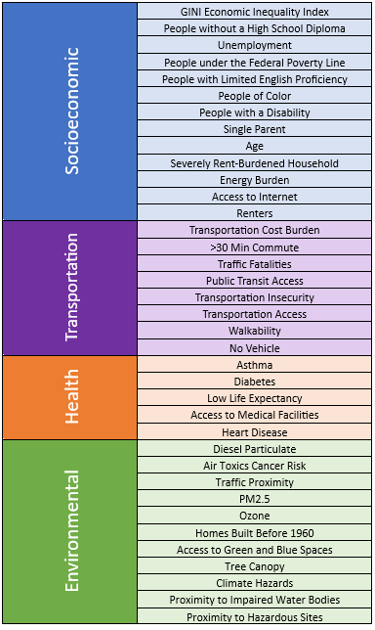
Demonstration
RI Social Equity Data Platform - Final (arcgis.com)

Slide 24
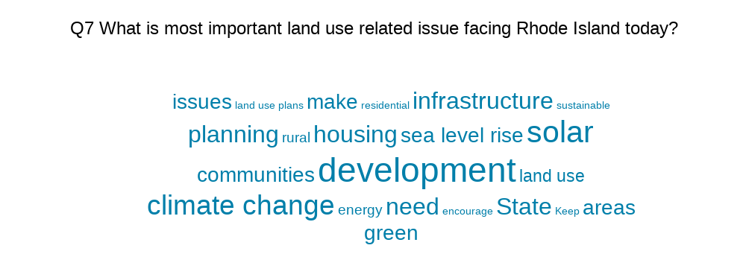
Planning Board Survey Response

Slide 25
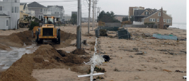
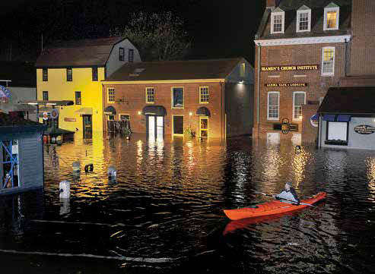
Identified, assessed, and addressed vulnerabilities of small businesses in Rhode Island.
Developed Risk Reduction Guides with practical information to help small businesses become more resilient.
Developed recommendations for municipal and state governments to support business resilience.
Risk Reduction for Small Business Resiliency Project
Notes:
Experience shows that 40% of small businesses affected by disaster never reopen; another 25% that do reopen fail. To reduce this impact to our businesses and our communities, the Risk Reduction for Small Business Resilience in RI project developed tools to support small businesses (less than 50 employees) to better prepare for extreme weather events.

Slide 26
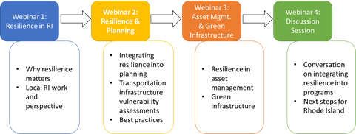
Transportation Planning & Natural Hazard
Resilience Seminar Series
In cooperation with FHWA
11/13/20
11/20/20
12/11/20
12/11/20
Notes:
RI Division of Statewide Planning, in coordination with the Federal Highway Administration, held a virtual training series for Rhode Island stakeholders beginning on November 13th. This seminar series helped planners to incorporate resilience into the transportation planning process, from a local, regional and statewide level to reduce the risks to Rhode Islanders and the economy from infrastructure disruption. Ten AICP Credits were available to attendees. This training was offered as a series of modules on 4 Friday afternoons starting on November 13th and continuing until December 11th.

Slide 27
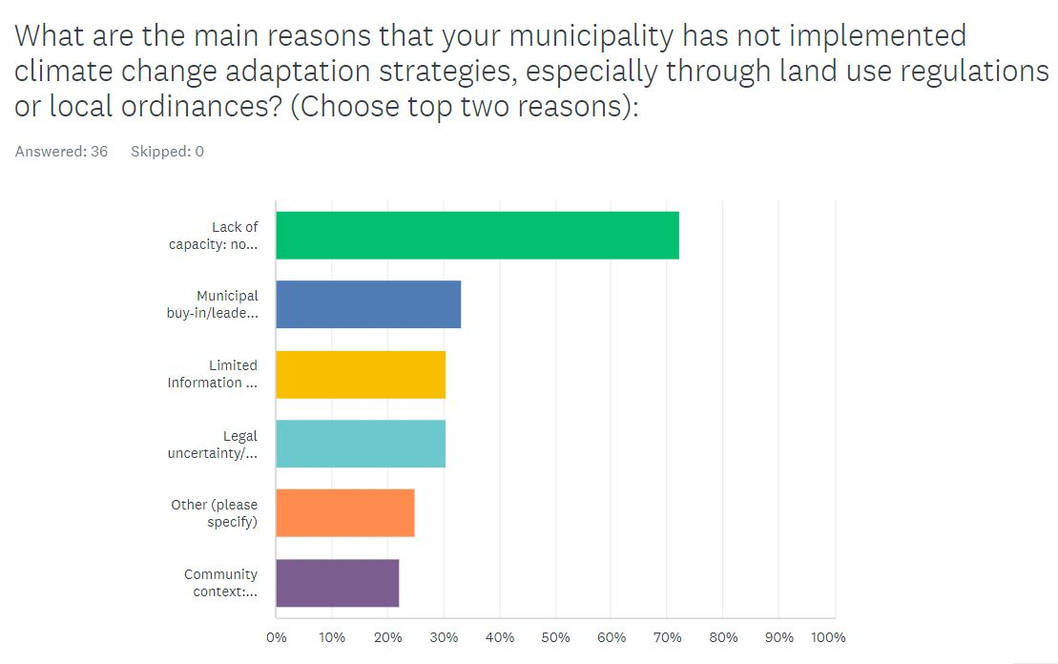
Rhode Island
Division of Statewide Planning
Barriers to Climate Adaptation Survey
Notes:
RIDSP reached out to municipal planners to determine the barriers that they face in implementing climate adaptation strategies. Here is a snapshot of their responses.

Slide 28
Work Directly Related to Climate Change,
Resilience, and Sustainability
    Ready Set Rhody - This EDA investment supports the Rhode Island Commerce Corporation with developing Ready Set Rhody, statewide GIS mapping that will identify small business districts that are most vulnerable to flooding caused by storms along key Main Streets in Rhode Island. The identified districts will receive targeted infrastructure vulnerability assessments and storm and disaster readiness preparedness strategies, which will bolster economic growth and promote economic resiliency throughout the region;
    Rt 114 Resilience Plan - With support from the Rhode Island Division of Statewide Planning – and in partnership with the Towns of Barrington, Warren, and Bristol – the Route 114 Resilience Plan is being developed to assess the vulnerability of this critical throughfare and to consider alternatives for reducing coastal flood risks and improving overall resilience in key areas of vulnerability along the route;
    Cumberland ordinance review, municipal ordinance work (EC4 funded and partnering with RIIB);
    EC4 planning support for public engagement;
    LRTP climate and resilience components.

Slide 29
Work Directly Related to Climate Change,
Resilience, and Sustainability
    Comprehensive Planning Standards Manual: Section 9 deals with natural hazards and climate change.
    Municipal Training - Continue to deliver a curriculum of training detailing land use and transportation responsibilities for volunteer members of municipal historic, planning and zoning boards and commissions as mandated by statute. For FY 25 this task will include:
      Continue to provide an introductory 3-hour workshop highlighting the responsibilities of the MPO and enabling authorities for municipal boards each quarter;
      Conduct at least one rendition of a one-hour continuing education course updating land use planning responsibilities and any potential legislative changes for the MPO and municipal boards. Can be done via Zoom or in-person gathering of municipal volunteers at a centrally held meeting;
      Continue to work with Partner agencies to provide other mandated education:
        Continue Historical District CAMP training through a cooperative agreement with RIHPHC to provide training from the National Alliance of Preservation Commissions for both in person and virtual training.
        Continue work with URI Nonpoint Source Education Municipal Officials (NEMO) through a cooperative agreement to develop an online, two-hour stormwater / flooding training for municipal planning boards using the URI Brightspace Engage learning platform.
        Work with URI CRC and RIDEM to develop an online course concerning climate change (CC) and sea level rise (SLR) for planning board members. Upgrade the Existing PrepRI webpage to URI Brightspace Engage learning platform for self-directed training similar to stormwater/flooding training.

Slide 31

Thank You!
Questions?
Meredith.Brady@doa.ri.gov
(401) 368-7601 (cell)

