Slide 1
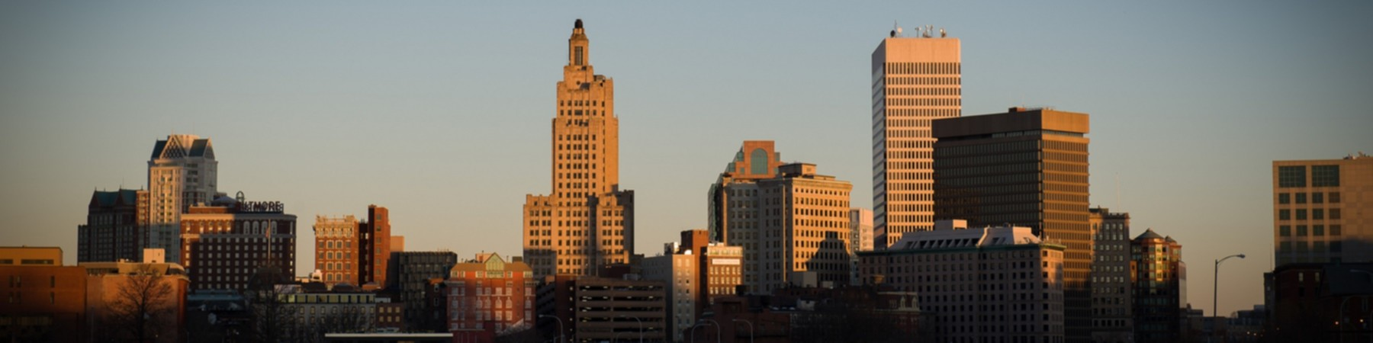

DELTA DENTAL OF RHODE ISLAND
HEALTHCARE SUMMIT
MAY 28, 2024

Slide 2
Dental Benefits Overview
1
R.I. Oral Healthcare Landscape
2
Delta Dental Statistical Snapshot
3
Access to Care &
Workforce Development
4

Slide 3

DENTAL BENEFITS OVERVIEW
The 7 Most In-Demand Employee Benefits Right Now
1. Retirement Savings And Financial Wellness Programs
According to a survey by the Employee Benefit Research Institute, more than 80% of workers expect their workplace retirement savings plan to be a source of income in retirement. Offering 401(k) plans, pension plans, and other retirement savings options demonstrates a company's commitment to its employees' long-term financial security. In addition, financial wellness programs that provide resources, education, and counseling can help employees manage their finances and reduce stress.
2. Insurance Coverage
Health insurance remains a top priority for employees, with 93% of companies with 50 or more workers offering those benefits, according to a Kaiser Family Foundation report. As healthcare costs continue to rise, comprehensive insurance coverage – including dental and vision benefits – is crucial for attracting talent. Employers should also consider offering life, disability, and accident insurance to provide employees with a well-rounded package that addresses their diverse needs.
Notes:
Reference:
Menickella, Brian. (June, 2023). The 7 Most In-Demand Employee Benefits Right Now. Forbes.
https://www.forbes.com/sites/brianmenickella/2023/06/16/the-7-most-in-demand-employee-benefits-right-now/?sh=c2841a57bd36

Slide 4
DENTAL BENEFITS OVERVIEW
Updated national trends based on latest available data as of November 2023 (Updated March 2024):
Estimated that 43% of U.S. population visited a dentist in 2021
Among adults, 61% have private dental insurance
Compared to other types of health care services, cost barriers are most severe for dental care services
  For example, 13% of the population reported cost barriers to dental care, compared to 4-5% for other health care services
Across all age groups, compared to individuals with public dental insurance or no dental insurance, those with private dental benefits have the lowest levels of cost barriers to dental care
Source: American Dental Association – Health Policy Institute Reporting November 2023 (Updated March 2024)
“National Trends in Dental Care Use, Dental Coverage, and Cost Barriers”

Slide 5
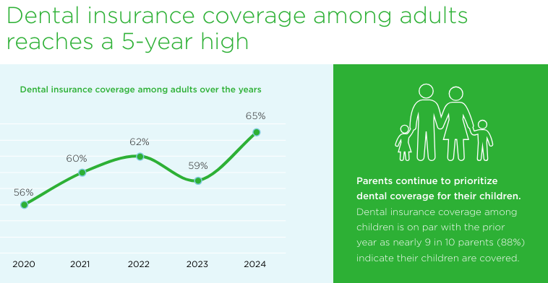

DENTAL BENEFITS OVERVIEW

Slide 6
DENTAL BENEFITS OVERVIEW
National Association of Dental Plans (NADP) research reveals record number of Americans with dental coverage:
Nationally, 88% of population enrolled in dental benefits programs
  A record 293 million Americans had dental coverage according to the NADP’s 2023 Benefits Report
Breakdown of population with dental coverage includes:
  Americans enrolled in employer-sponsored or other group plans;
  Individual dental benefit plan purchasers; and
  Those enrolled in publicly funded programs
Publicly funded dental enrollment is increasing significantly

Slide 7
RHODE ISLAND ORAL HEALTHCARE LANDSCAPE
Census Bureau estimates Rhode Island population at 1,095,962
  As of July 2023
  Down from 1,097,371 in 2020 Census
92% of R.I.’s population has some form of dental coverage
  Well above national average
RI ranked #6 in nation for adult dental visits
RI employer groups offer some of the richest dental benefit packages in the nation

Slide 8
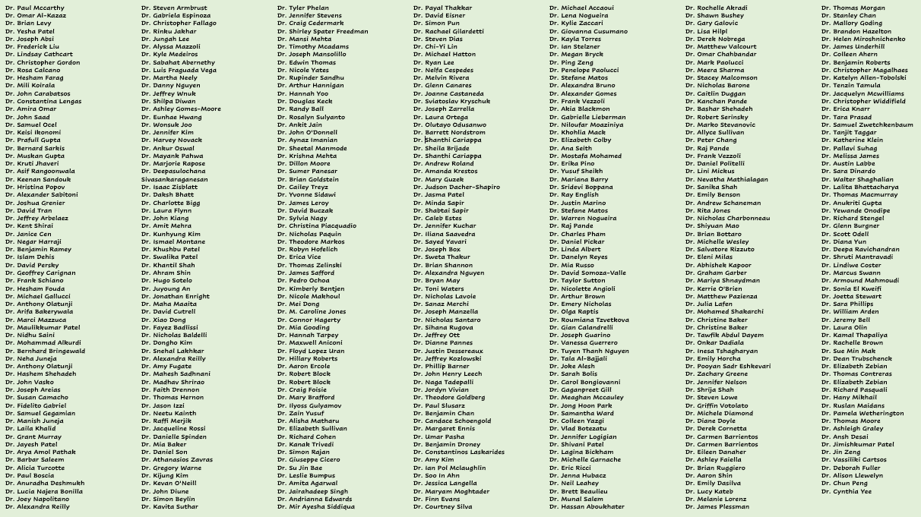
RHODE ISLAND ORAL HEALTHCARE LANDSCAPE
NEWLY CREDENTIALED DENTISTS 2013 - 2023
452 Dentists Credentialed last 10 years / 65 different dental schools / Average age 37
72% under age 40 / Tufts graduates at 93 / Boston U. at 119 / UCONN at 13
~60% are still practicing in Rhode Island

Slide 9
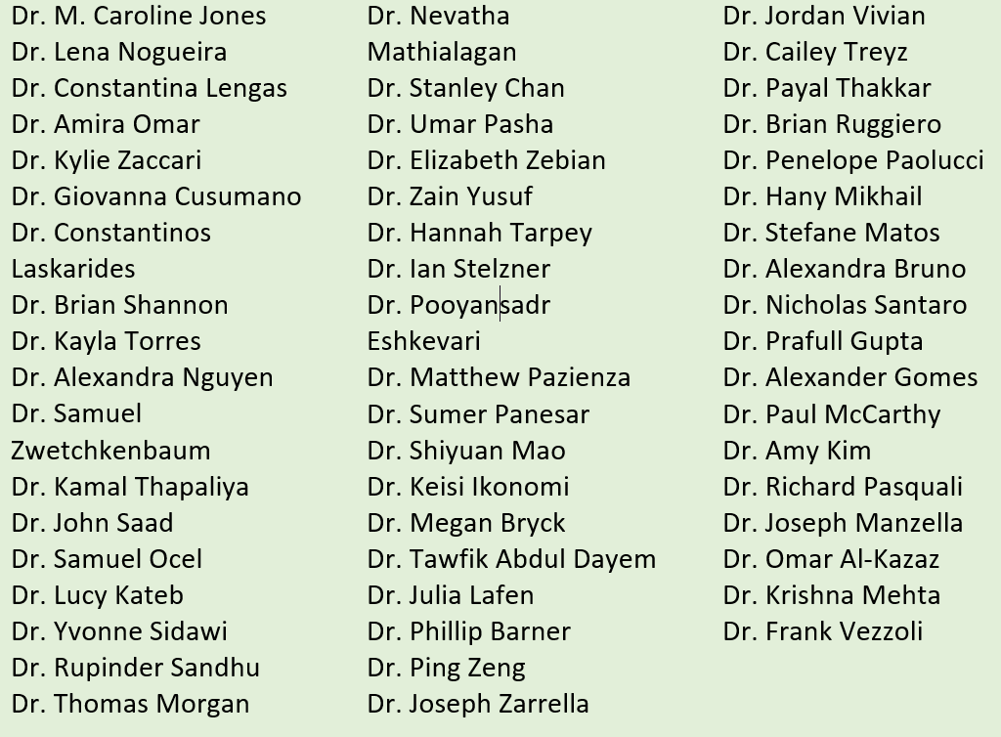
RHODE ISLAND ORAL HEALTHCARE LANDSCAPE
STATISTICAL SNAPSHOT
Credentialed = 54
Average age = 35
Under Age 40 = 83%
Dental schools = 26
  Tufts = 14 graduates
  Boston U. = 8 graduates
  UCONN = 3 graduates
NEWLY CREDENTIALED RI DENTISTS - 2023 ONLY

Slide 10
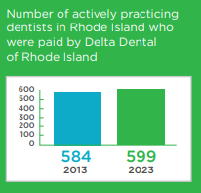
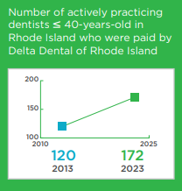
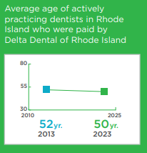

RHODE ISLAND ORAL HEALTHCARE LANDSCAPE
The Rhode Island dental market can be examined by focusing on workforce demographics and access to dental care
Utilizing DDRI’s database of claims paid to both in-network and out-of-network dentists, along with credentialing data, a comprehensive view of actively practicing dentists in Rhode Island can be reported.

Slide 11
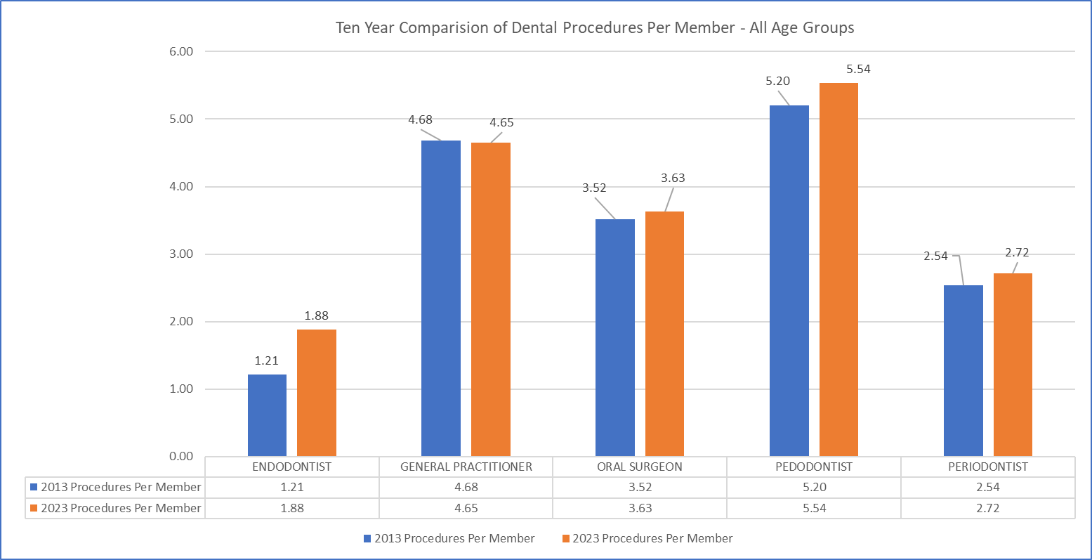
RHODE ISLAND ORAL HEALTHCARE LANDSCAPE
STATISTICAL SNAPSHOT 2013 VS. 2023
Slight increase in Endodontic volume of service per member
General Dentists and other specialists volume of service per member is relatively flat
43% increase in under age 40 dentists providing care vs. 8% decrease in over age 40

Slide 12
RHODE ISLAND ORAL HEALTHCARE LANDSCAPE
RI dental carriers are heavily regulated:
DBR (Department of Business Regulations)
OHIC (Office of Health Insurance Commissioner)
SORI, IRS, etc.

Slide 13
DELTA DENTAL STATISTICAL SNAPSHOT
407,000 members (DDRI in-state and out-of-state)
Nearly 3,000 active DDRI clients:
  State of Rhode Island
  Citizens Financial Group
  Lifespan
  RI Interlocal Trust
Client Financial Arrangements (as a % of membership):
  Self-insured = 66%
  Fully-insured = 34%
Client cost obligations built into premiums:
  State premium tax = ~$19million over last 10 years
  Broker commissions = ~$24million over last 10 years
Program includes additional Value-based-care reimbursements:
  More than $50million in value based care reimbursements made to RI dentists over last 10 years
Net premium per month per member = <$31

Slide 14
DELTA DENTAL STATISTICAL SNAPSHOT
DDRI also has another 140,000 members who live out-of-state through its Rhode Island client base:
Citizens
Hasbro
FM Global
Amica
Toray
etc.

Slide 15
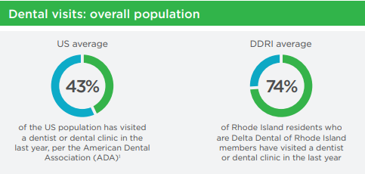
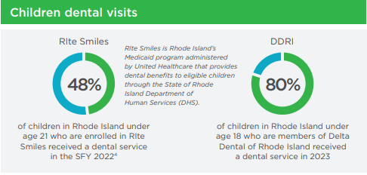
DELTA DENTAL STATISTICAL SNAPSHOT
Delta Dental of Rhode Island members are recording dental visits at a pace well above national averages
Delta Dental of Rhode Island members under age 18 are receiving services at local and nation leading levels

Slide 16

DELTA DENTAL STATISTICAL SNAPSHOT
Overall satisfaction
92%
Satisfied w/ availability
of dentists
93%
Satisfied w/ quality
of dental treatment
98%
Would recommend
to family/friends
94%
Satisfied w/ customer service experience
94%
Having insurance increases likelihood of going to dentist
95%

Slide 17
ACCESS TO CARE & WORKFORCE DEVELOPMENT
Primary Areas of Support

Slide 18
ACCESS TO CARE & WORKFORCE DEVELOPMENT
Sample Beneficiaries of Support
Lifespan/RI Hospital – Samuels Sinclair Dental Center
Rhode Island Department of Education
Rhode Island Health Professional Loan Repayment Program
Rhode Island Free Clinic
RI Oral Health Foundation & RI Mission of Mercy
Rhode Island Kids Count
Rhode Island Health Center Association
Children’s Friend
C.C.R.I. - Dental Hygiene Program
Providence Community Health Centers
Blackstone Valley Community Health Care
Thundermist Health Center
Dental Lifeline Network
Wood River Health
Tri-County Community Action Agency
Junior Achievement of Rhode Island
Care New England Health System
Tufts University School of Dental Medicine
Crossroads Rhode Island
Comprehensive Community Action Program
CareLink
American Heart Association

Slide 19
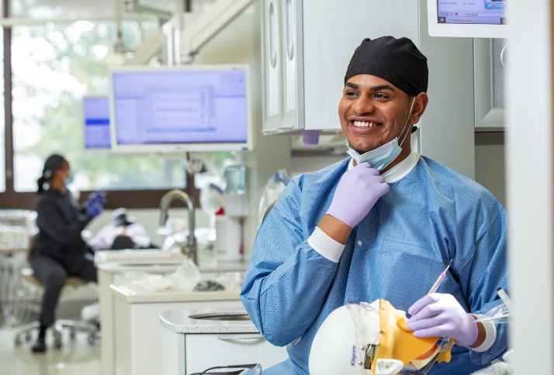
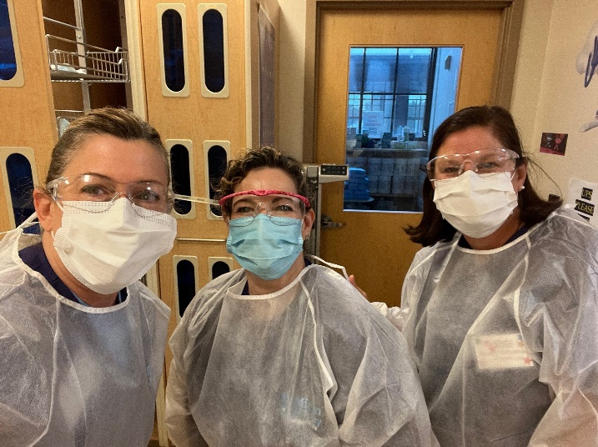

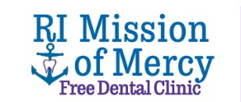
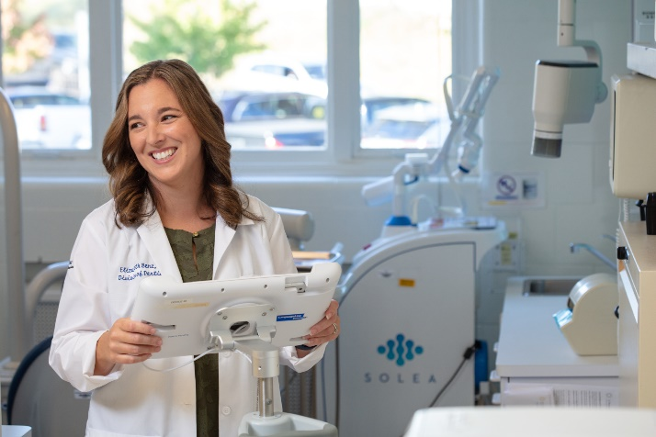
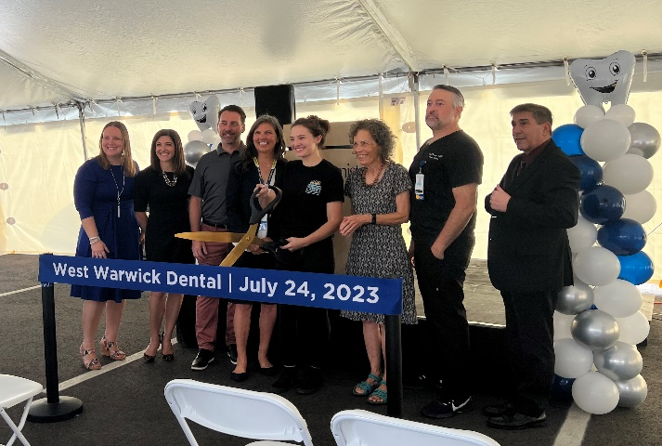


ACCESS TO CARE & WORKFORCE DEVELOPMENT
Investing in RI’s Workforce
Increasing Access
to Care
Expanding and supporting CCRI’s Dental Hygiene Program
10 years of RI
Mission of
Mercy
Creating RI’s first oral surgery residency program
Expanding Access in the West Bay

Slide 20


ACCESS TO CARE & WORKFORCE DEVELOPMENT
Local & National Example for Successful Workforce Development
DDRI/CCRI asked to share partnership success with:
Hawaii Dental Service (DDHI)
Hawaii Chamber of Commerce
University of Hawaii Director of Workforce Development
Healthcare Association of Hawaii Workforce Development
Strong interest from other states to replicate this program to address the national shortage of dental hygienists

Slide 21



FUTURE OPPORTUNITIES
ACCESS TO CARE & WORKFORCE DEVELOPMENT
Continued Focus on Workforce Development
DENTAL HYGIENISTS: Expand the CCRI Partnership
Additional scholarships
Potential longer time commitment to working in Rhode Island
DENTAL ASSISTANTS: CCRI, RI Department of Education, and Westerly Education Center opportunities
Aligns with high school career and technical training programs to build Oral Health Career Pathways
Targeting: East Providence, Lincoln, Westerly, others
PROVIDER RECRUITMENT: Potential of expanding contributions to Loan Repayment Programs for Providers working in Community Health Centers

