Slide 2
In 2014, RI was leading the world in protecting our citizens.
The RI DEM created a new category called “Extremely Hazardous Wastes” that includes chemotherapy drugs.
Today a new term has come onto the horizon.
Non-threshold contaminate.
This includes cytotoxic chemotherapy exposure where ANY amount is harmful; anything above zero is dangerous.
Notes:
.

Slide 3
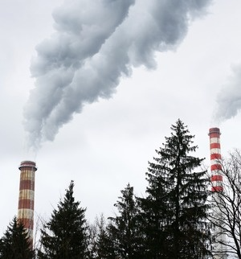
We cannot allow non-threshold contaminates to be incinerated. A high heat waste facility will destroy any living thing. It will not destroy drugs.
Common chemotherapy drugs contained in cancer patients’ human waste will come right out of the stack of any proposed incinerator.

Slide 4
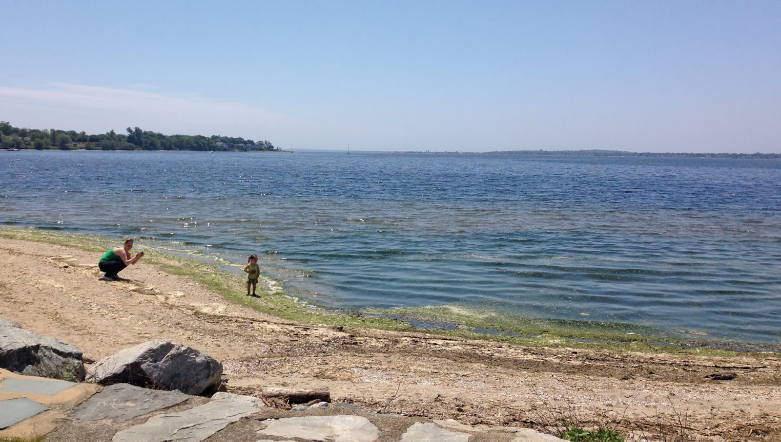
What is happening to these non-threshold contaminates right now?
Hospitals and outpatients are flushing this cytotoxic human waste directly into toilets where they ultimately end up in our water.
Notes:
The current situation is that hospitals are protecting the highly paid pharmacists and workers in the pharmacy under United States pharmacopeia (USP) 800 and are pretending that these chemicals are gone.
One of the greatest exposures is a nurse emptying a bedpan into a toilet where the janitors are cleaning up non-threshold cytotoxic chemotherapy drugs.
The staff at this level are mostly women and minorities. The European Parliament directive addresses the situation is a serious violation of environmental equity

Slide 5
House Bill H5923 only solves half of the problem: it prevents the contamination of our air.
The House should protect BOTH our water AND our air from these extremely dangerous non-threshold chemicals.
Our lives and the lives of future generations depend on it.

Slide 6
Pharmaceutical companies should bear the cost of collecting cytotoxic human waste at the source.
The cost of preventing cancer and birth defects is minimal compared to the human suffering cause by this terrible disease.

Slide 7
This is a global crisis.
Rhode Island must lead the world again.
The time to act is now.
Notes:
A bill without a solution is complaining. But the house should enact is a combination of this bill with the 2020 version of House 7840
This will provide protection of our but our waterways our drinking water and our air from these non-threshold chemicals
It will protect our most vulnerable populations as well as often ignored minorities and have the control of these chemicals as part of the treatment.
The cost of cancer prevention is minimal compared the human suffering of disease

Slide 8
Jim Mullowney, CEO Pharma-Cycle, LLC
www.pharma-cycle.com
jmullowney@pharma-cycle.com

